Slide 1
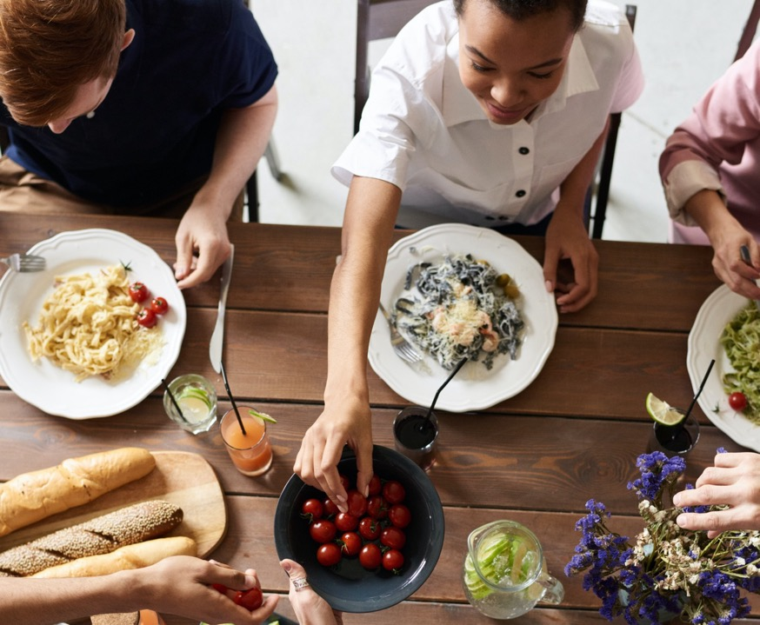
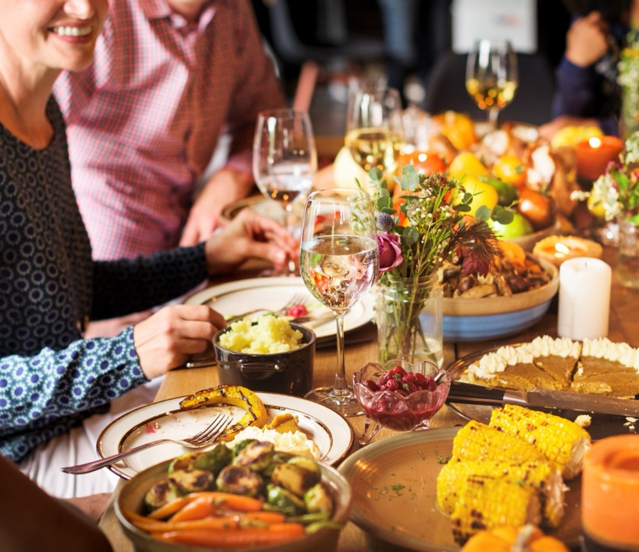
Exploring the heart of the Christian message of hope over four meals.

Slide 2
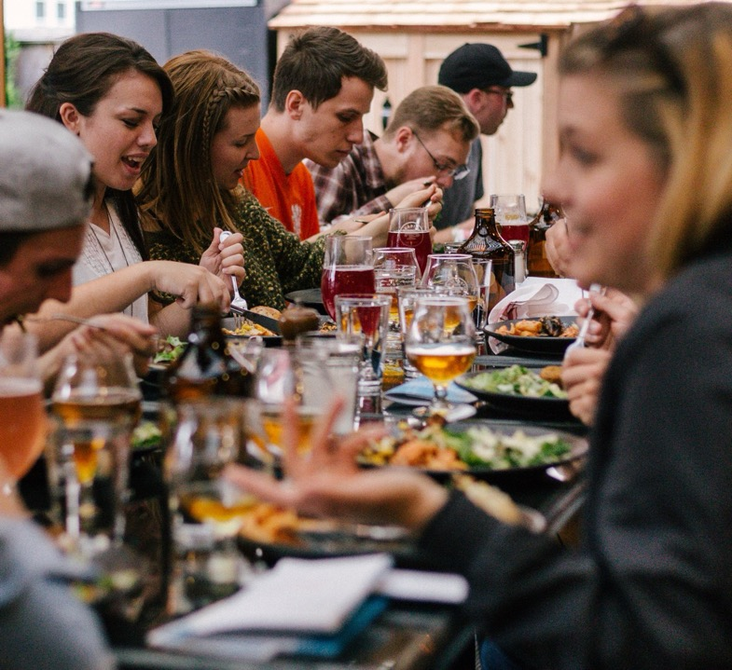
Welcome!
To 4 unique meals over 4 weeks exploring 4 big ideas about God around the table.

Slide 3
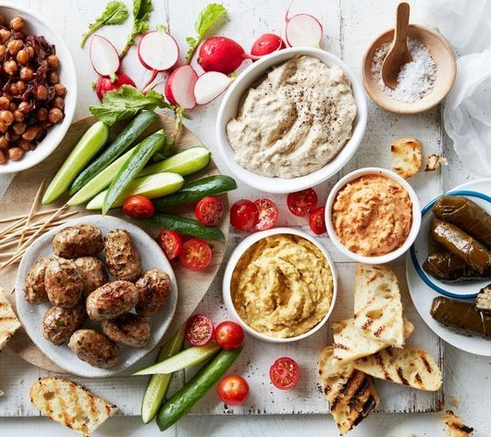
Week Three
The
Great
Rescue

Slide 4
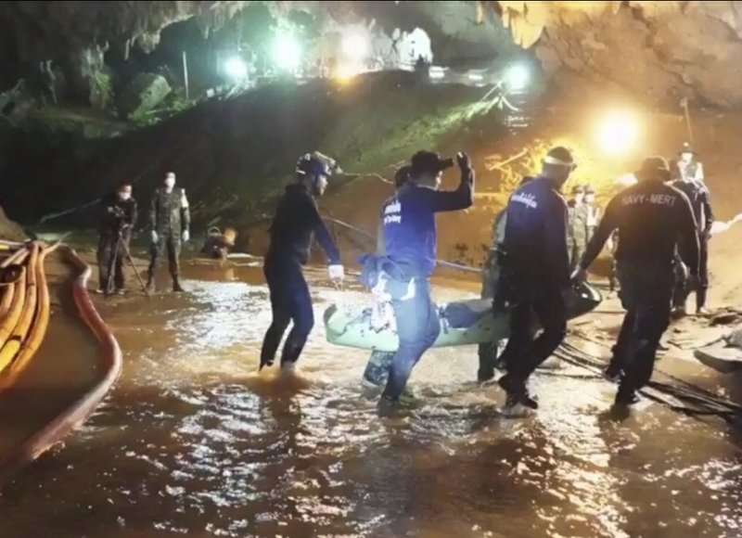
Thai NavySEAL Facebook Page on Wednesday, July 11, 2018

Slide 5
Q.
Have you ever needed rescuing?

Slide 6
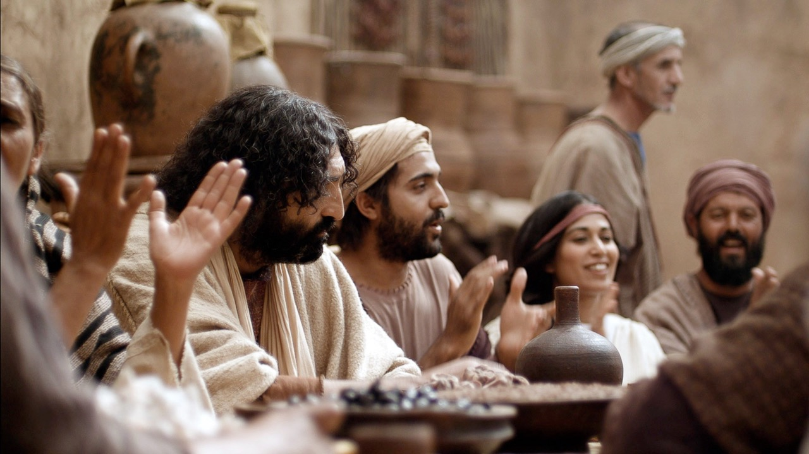
Taste & See
Week 3
www.LumoProject.com

Slide 7
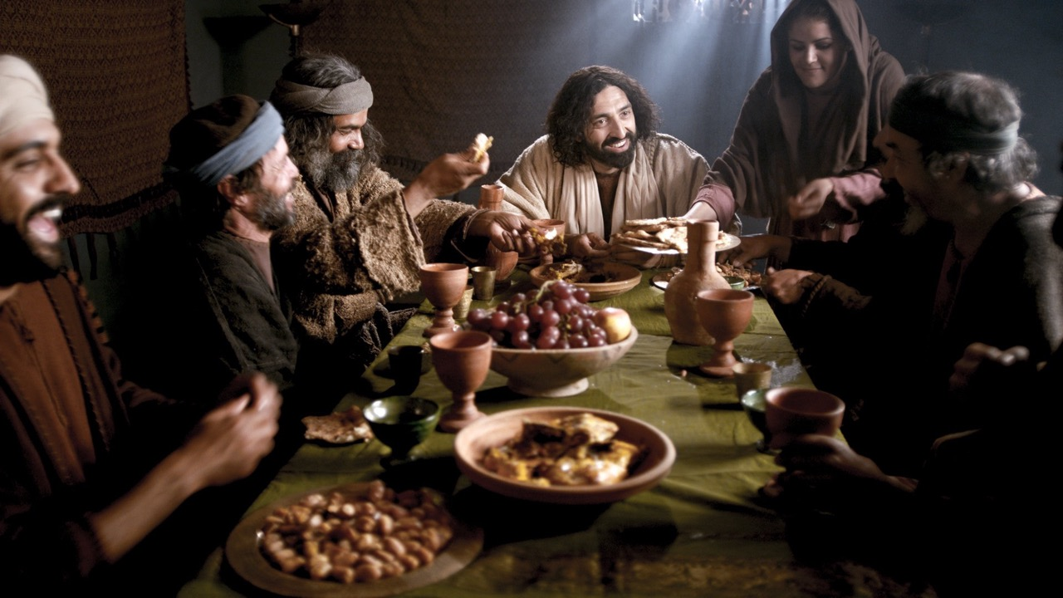
Taste & See
Week 3
www.LumoProject.com
Notes:
Other religious leaders would never share a meal with people like this. But Jesus and His disciples ate and talked with them.

Slide 8
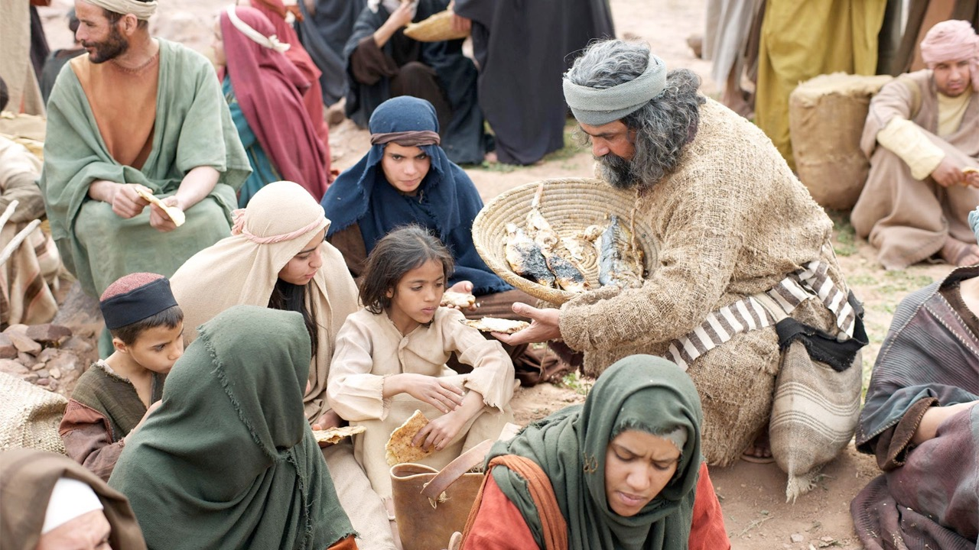
Taste & See
Week 3
www.LumoProject.com

Slide 9
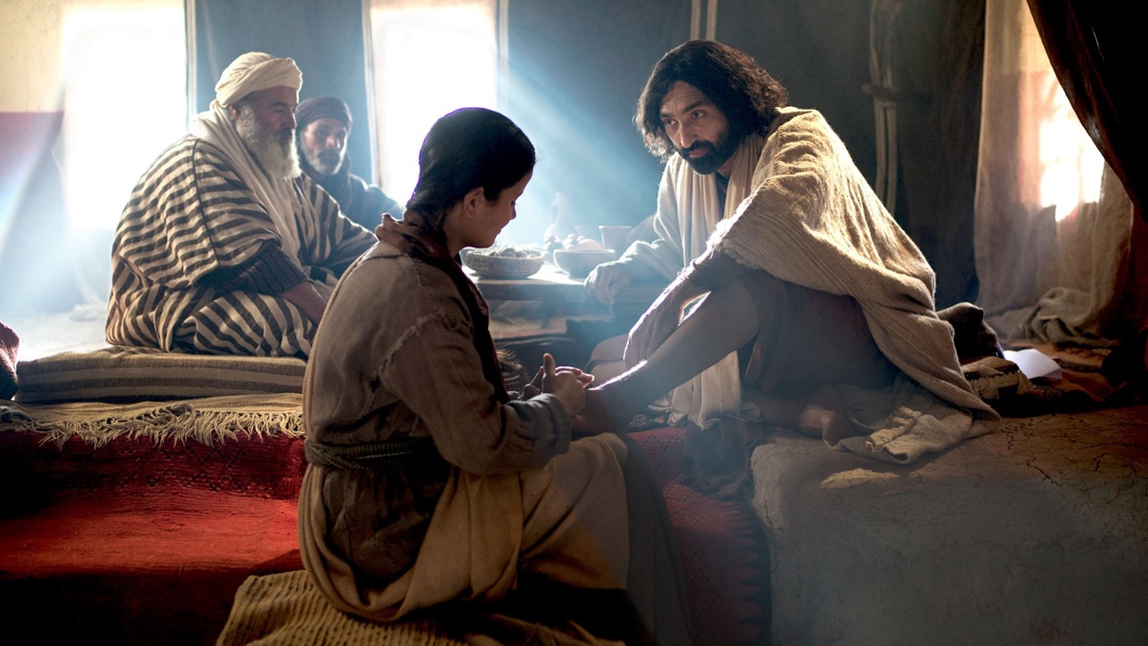
Taste & See
Week 3
www.LumoProject.com

Slide 10
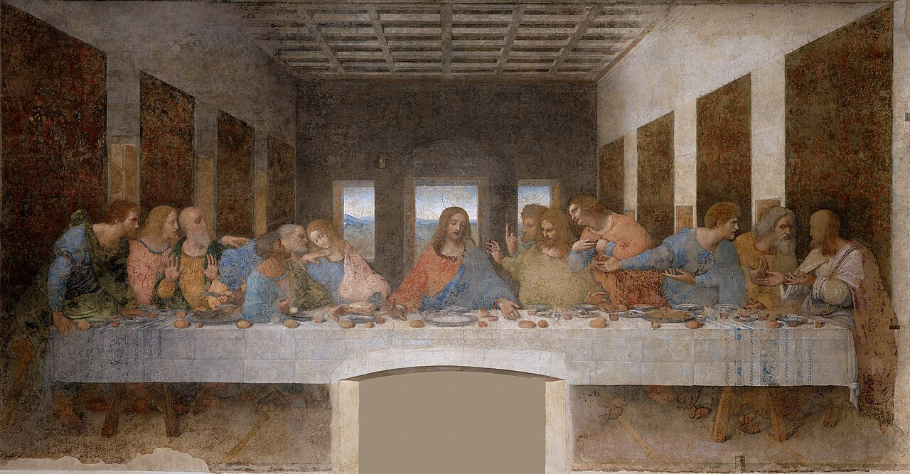
Taste & See
Week 3
The Last Supper
Leonardo Da Vinci
Wikimedia Commons LICENSE

Slide 11
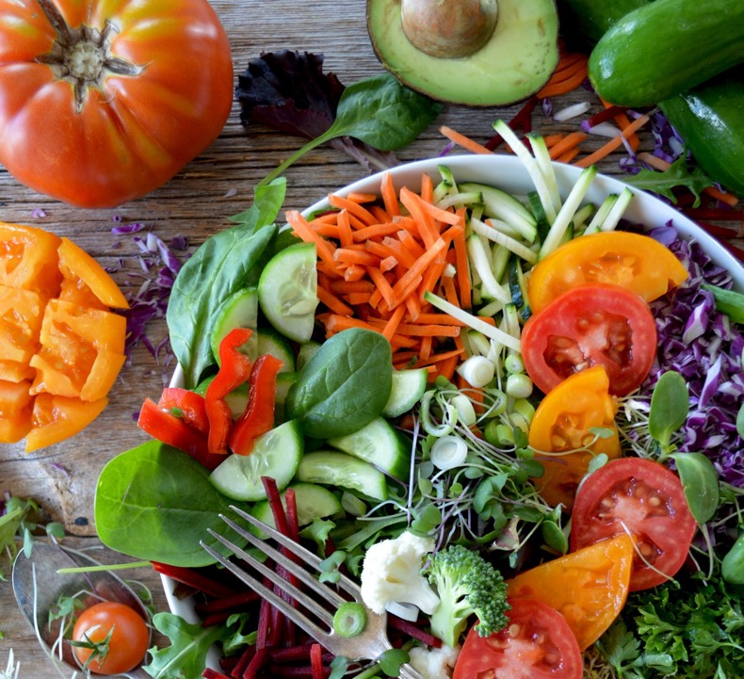
Week One
It Was Good!

Slide 12
Taste & See
Week 3
And God saw that it was good.
Genesis 1

Slide 13
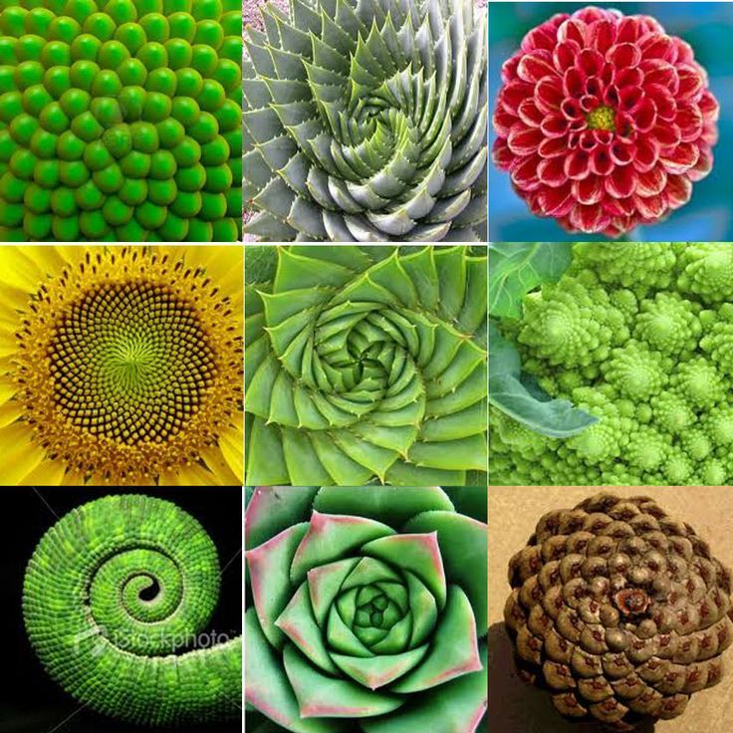
Taste & See
Week 3

Slide 14
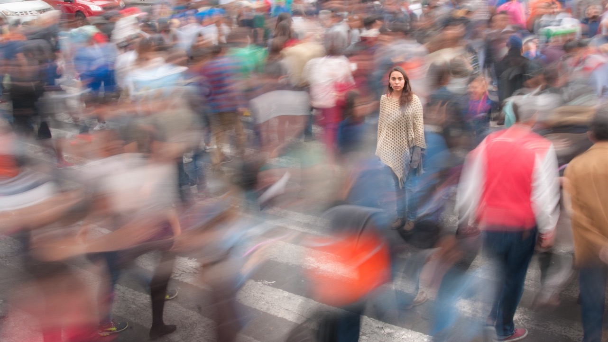
Taste & See
Week 3
Made in God’s image
Q.
If bearing the image of God to the creation and to each other is our role, how do you think we’re doing?

Slide 15
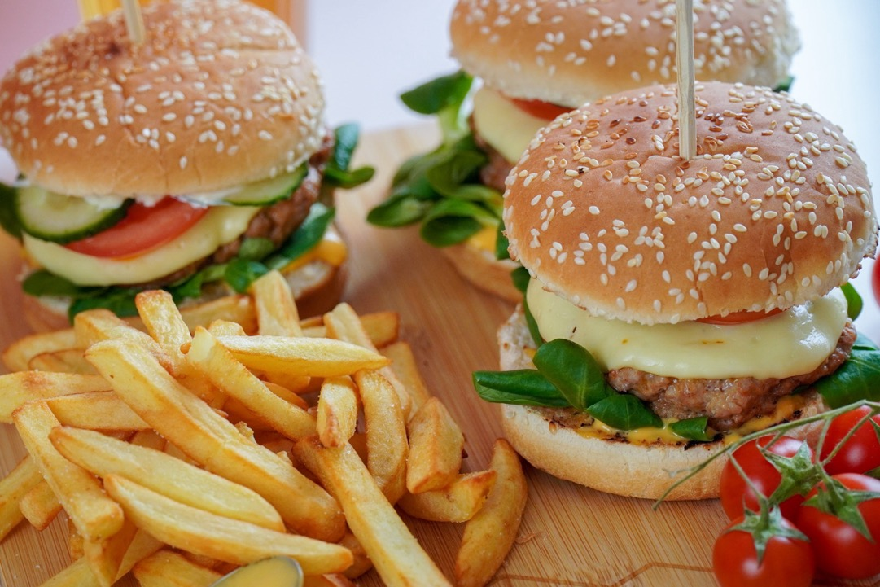
Week Two
What’s Gone Wrong?

Slide 16
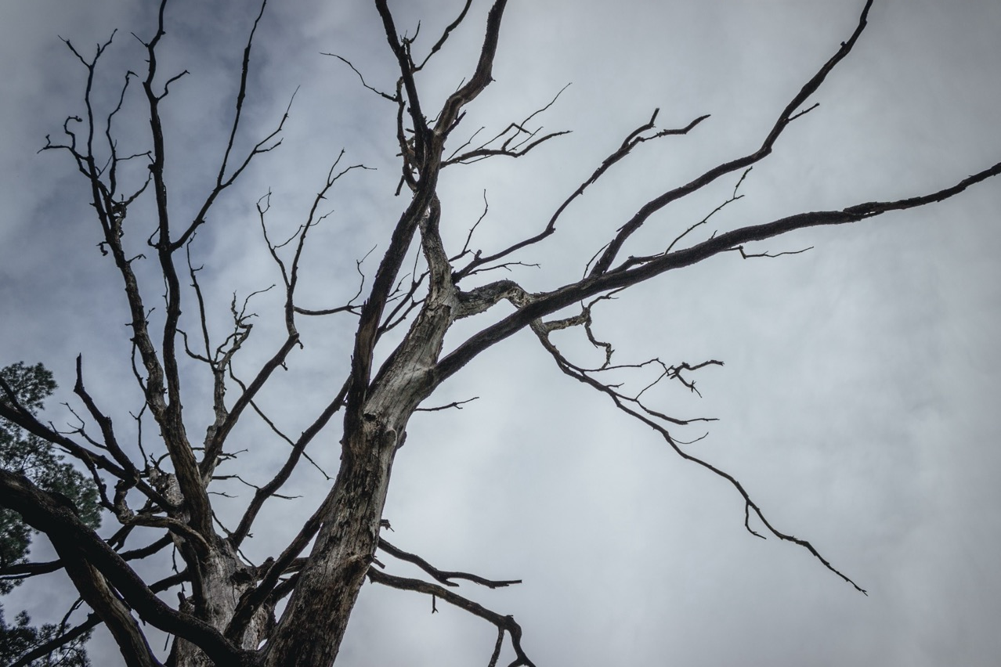
Taste & See
Week 3
Alienation and Death

Slide 17
Week 1
Taste & See
Week 3
Optional section on the Bible

Slide 18
Taste & See
Week 3

Slide 20
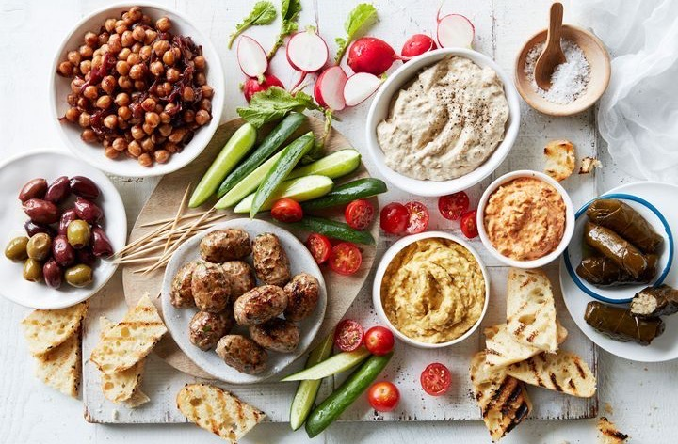

Slide 21
Taste & See
Week 3
The comfort and the challenge of God’s judgement

Slide 22
Taste & See
Week 3
“My last resistance to the idea of God’s wrath was a casualty of the war in the former Yugoslavia, the region from which I come. According to some estimates, 200,000 people were killed and over 3,000,000 were displaced. My villages and cities were destroyed, my people shelled day in and day out, some of them brutalised beyond imagination, and I could not imagine God not being angry.

Slide 23
Taste & See
Week 3
Or think of Rwanda in the last decade of the past century, where 800,000 people were hacked to death in one hundred days! How did God react to the carnage? By doting on the perpetrators in a grandfatherly fashion? By refusing to condemn the bloodbath but instead affirming the perpetrators’ basic goodness? Wasn’t God fiercely angry with them?

Slide 24
Taste & See
Week 3
Though I used to complain about the indecency of the idea of God’s wrath, I came to think that I would have to rebel against a God who wasn’t wrathful at the sight of the world’s evil. God isn’t wrathful in spite of being love. God is wrathful because God is love.”
Miroslav Volf

Slide 25
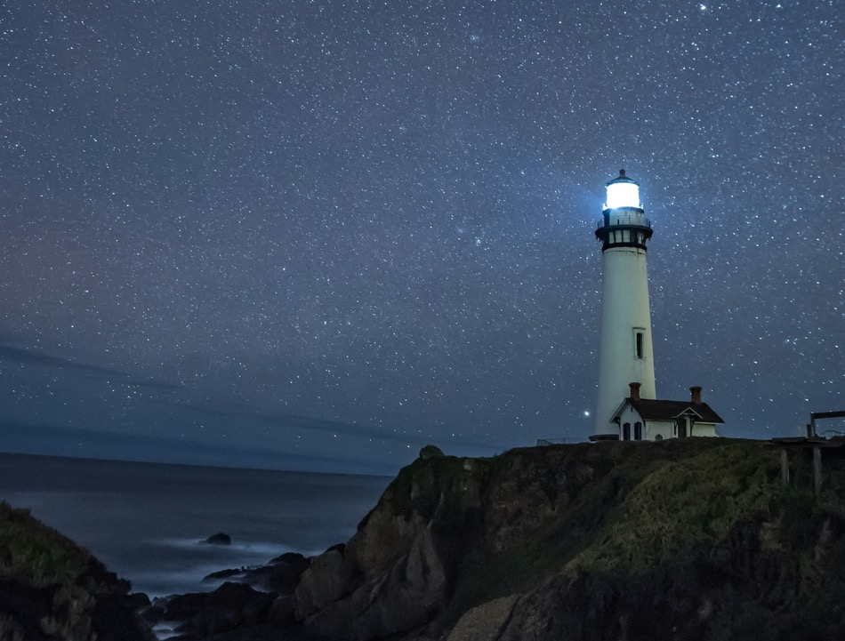
Q.
What kind of rescue do you think we need?

Slide 26
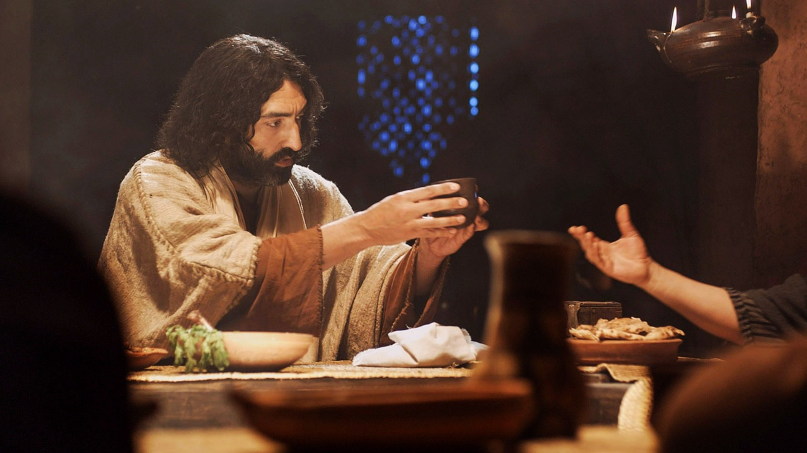
www.LumoProject.com
Notes:
They all drank from it.

Slide 27
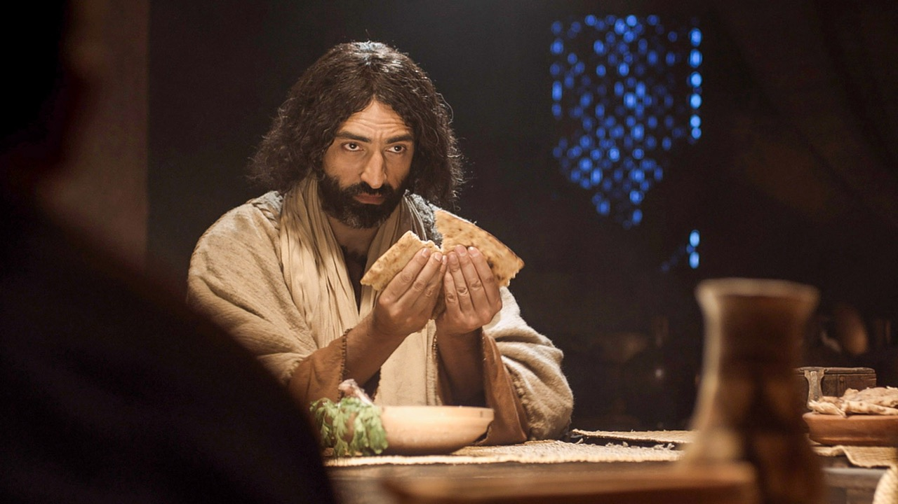
Taste & See
Week 3
And he took bread, gave thanks and broke it, and gave it to them, saying, “This is my body given for you; do this in remembrance of me.”
²⁰ In the same way, after the supper he took the cup, saying, “This cup is the new covenant in my blood, which is poured out for you.”
Luke 22:19-20
www.LumoProject.com

Slide 28
Taste & See
Week 3
And he took bread, gave thanks and broke it, and gave it to them, saying, “This is my body given for you; do this in remembrance of me.”
Luke 22:19
www.LumoProject.com

Slide 29
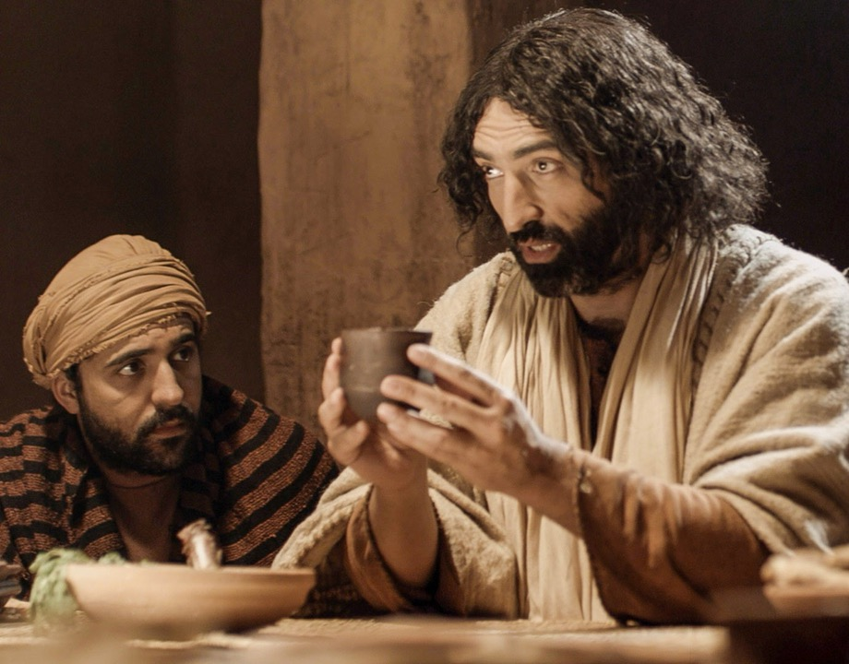
Taste & See
Week 3
²⁰ In the same way, after the supper he took the cup, saying, “This cup is the new covenant in my blood, which is poured out for you.”
Luke 22:20
It Was Good
www.LumoProject.com

Slide 30
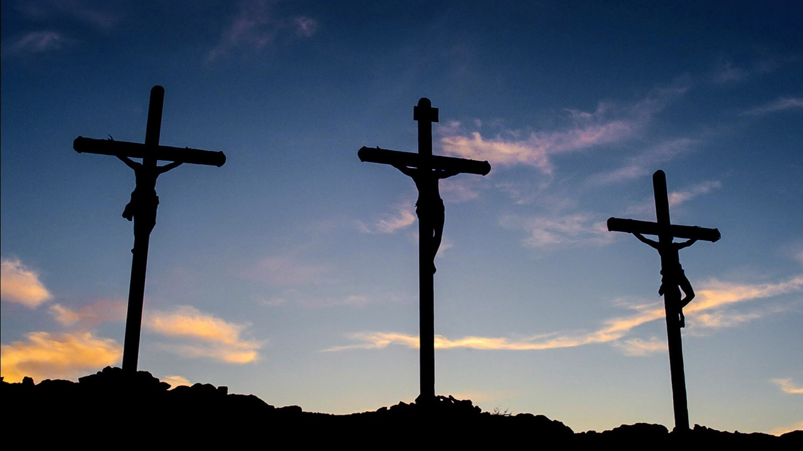
Week 1
Taste & See
Week 3
Taste & See
www.LumoProject.com

Slide 31
Week 1
Taste & See
Week 3
Taste & See
The meaning of Jesus’ death…
www.LumoProject.com

Slide 32
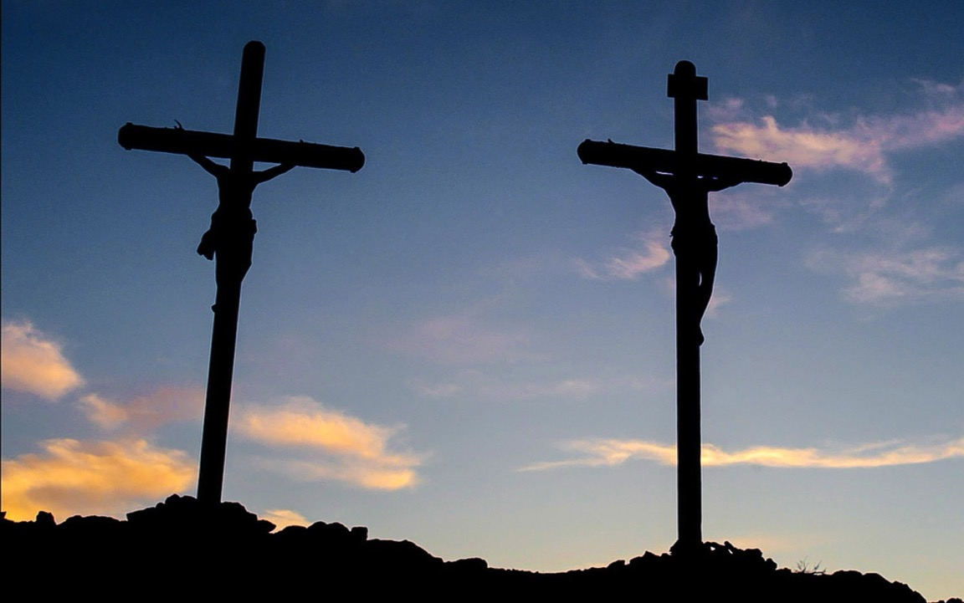
Taste & See
Week 3
Jesus’ death addresses…
The SIN problem
www.LumoProject.com

Slide 33
Taste & See
Week 3
Jesus’ death addresses…
The SIN problem
The SLAVERY problem
www.LumoProject.com

Slide 34
Taste & See
Week 3
Jesus’ death addresses…
The SIN problem
The SLAVERY problem
The BELONGING problem
www.LumoProject.com

Slide 35
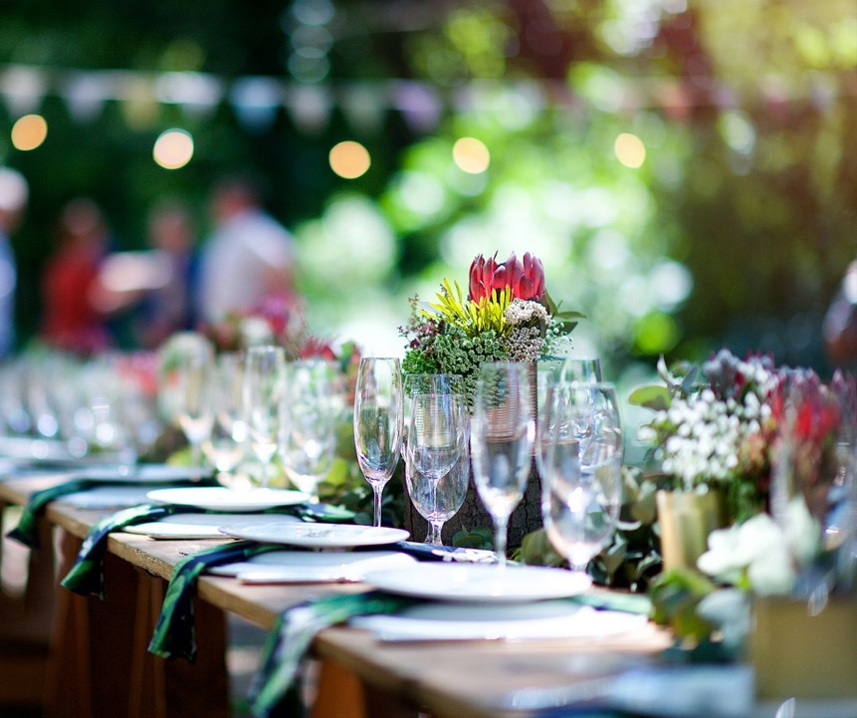
Week Four
Future Hope

Slide 36
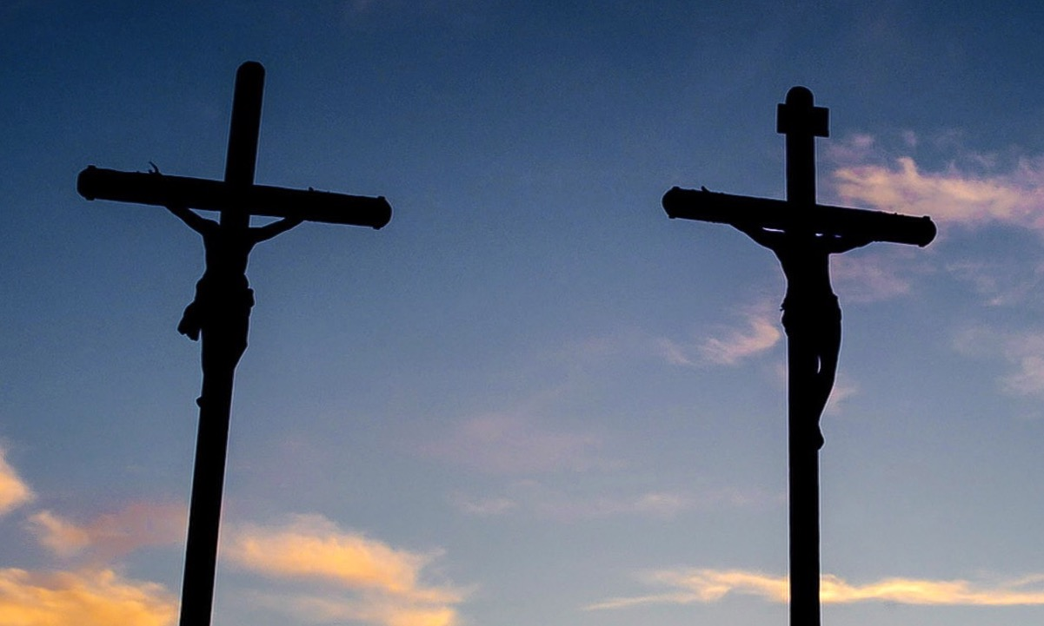
Taste & See
Week 3
Q.
Take some time to consider:
What was one thing struck me most tonight?
If this is true, what does it mean for my relationship with God?
www.LumoProject.com

Slide 37
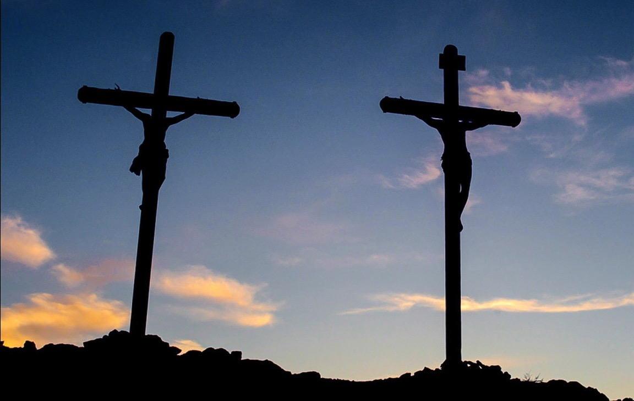
“Taste and see that the Lord is good; blessed is the one who takes refuge in him.”
Psalm 34:8

Slide 38
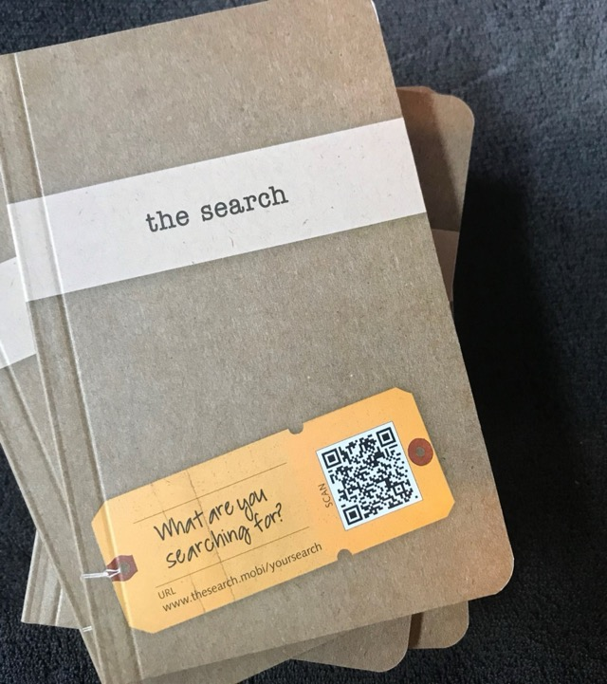
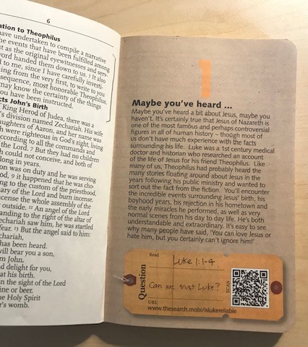
We invite you to read chapters 22 to 24 in Luke’s account this week.

Slide 39
EXTRA SLIDES
Some alternative colour options

Slide 40
Exploring the heart of the Christian message of hope over four meals.

Slide 41
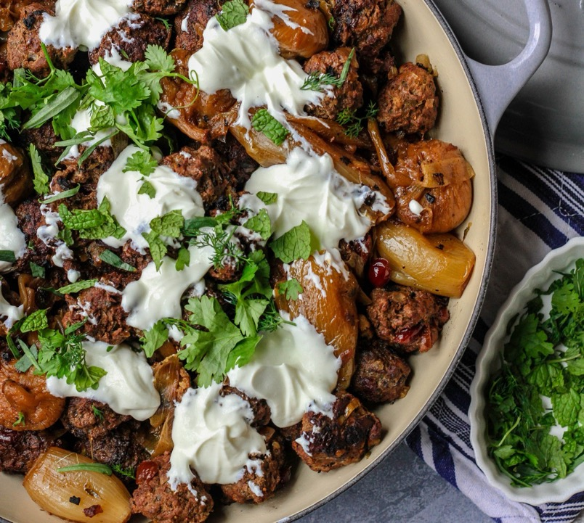
Week Three
The
Great
Rescue

Slide 42
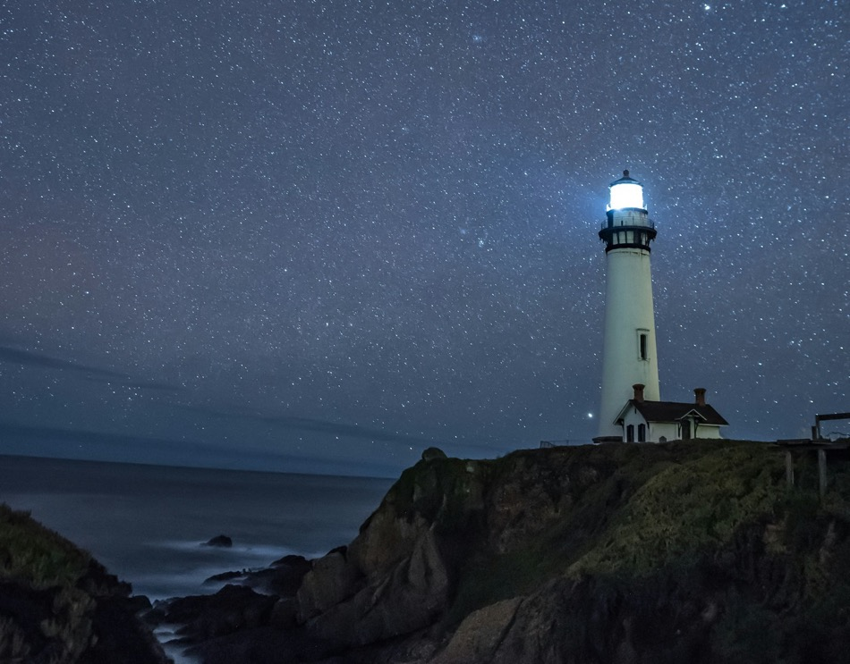
Taste & See
Week 3
Q.
What kind of rescue do you think we need?

Slide 43
Taste & See
Week 3
Q.
Take some time to consider:
What was one thing struck me most tonight?
If this is true, what does it mean for my relationship with God?
www.LumoProject.com

Slide 44
