Slide 1
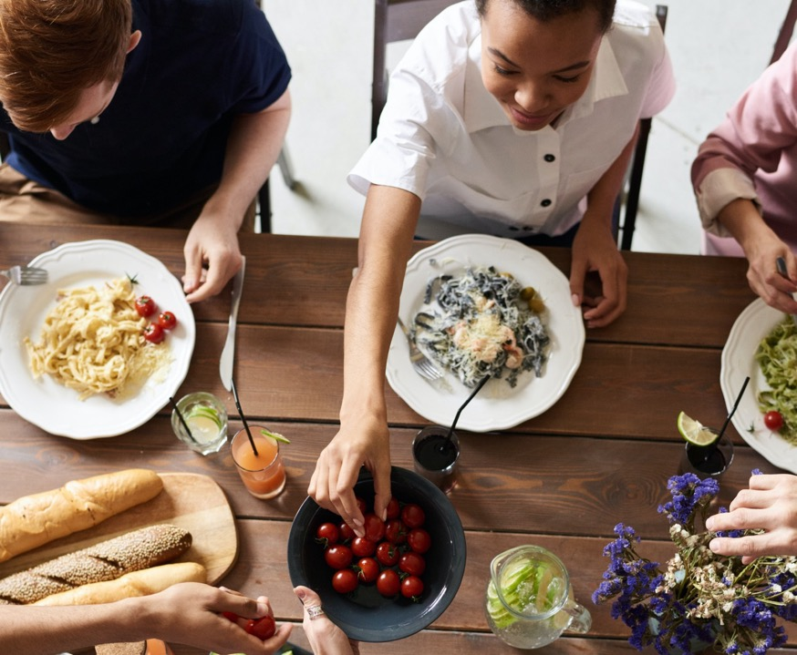
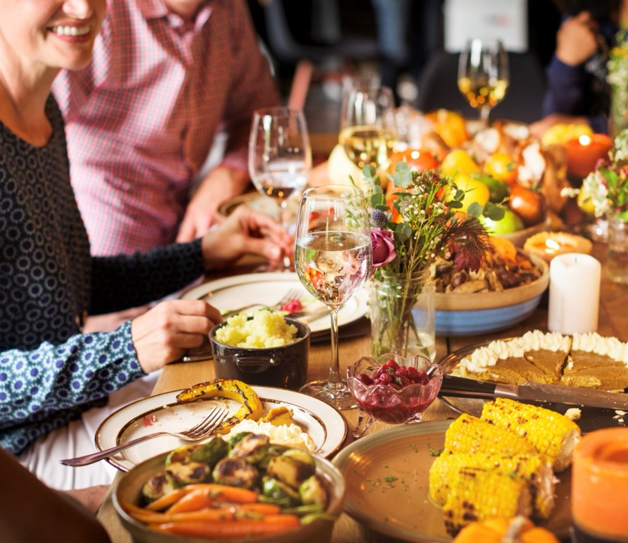
Exploring the heart of the Christian message of hope over four meals.

Slide 2
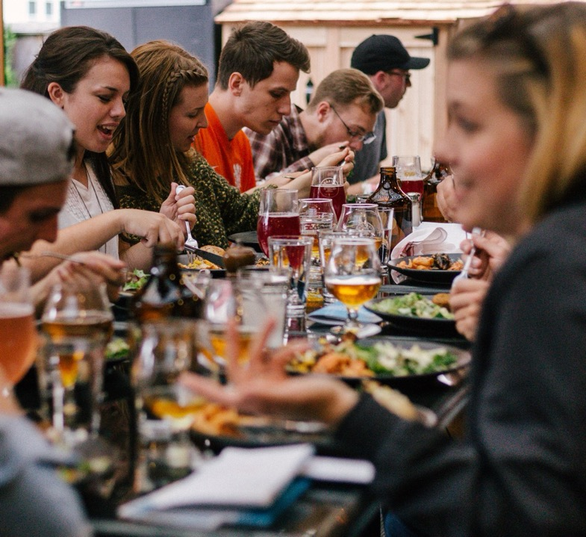
Welcome!
To 4 unique meals over 4 weeks exploring 4 big ideas about God around the table.

Slide 3
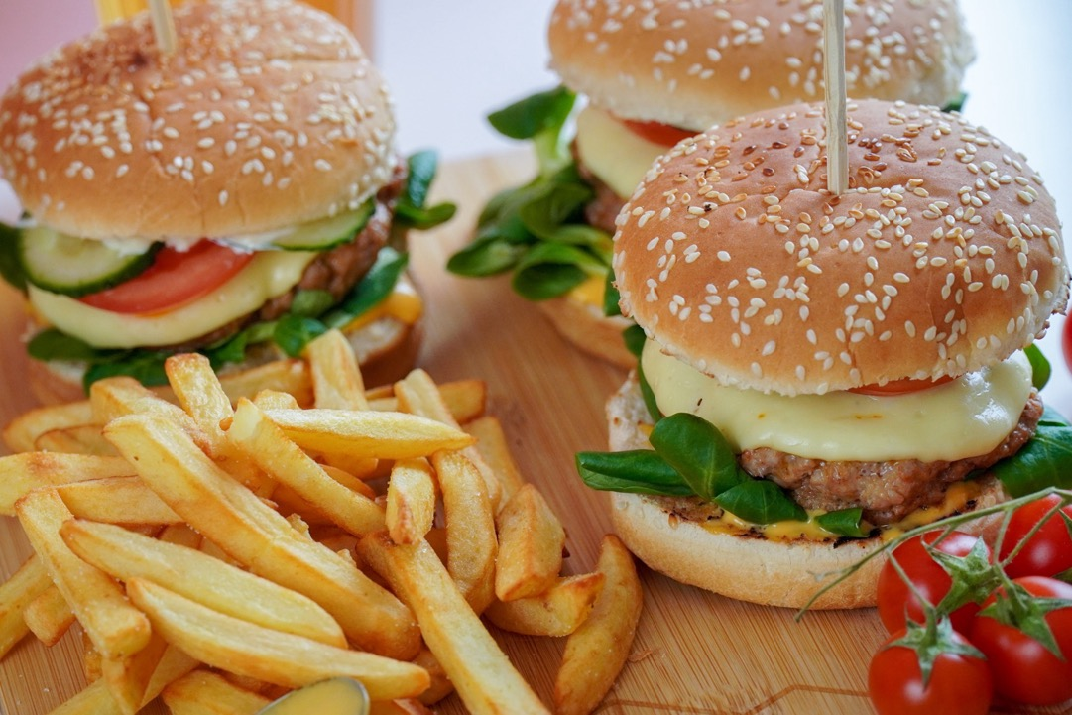
Week Two
What’s Gone Wrong?

Slide 4
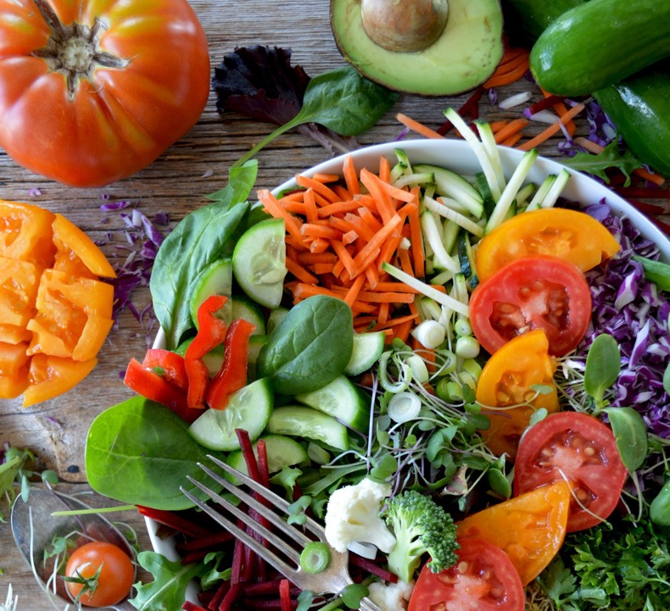
Week One
It Was Good!

Slide 5
Week Two
What’s Gone Wrong?

Slide 6
Q.
What is your go-to junk food?
What is one of the things wrong with the world?

Slide 7
Week One
It Was Good!

Slide 8
Week 1
Taste & See
Week 1
Taste & See

Slide 9
Taste & See
Week 1

Slide 11
Taste & See
Week 3
Made in God’s image
Q.
If bearing the image of God to the creation and to each other is our role, how do you think we’re doing?

Slide 12
Taste & See
Week 2
“…a race to whom something happened.”
Jean-Paul Satre

Slide 13
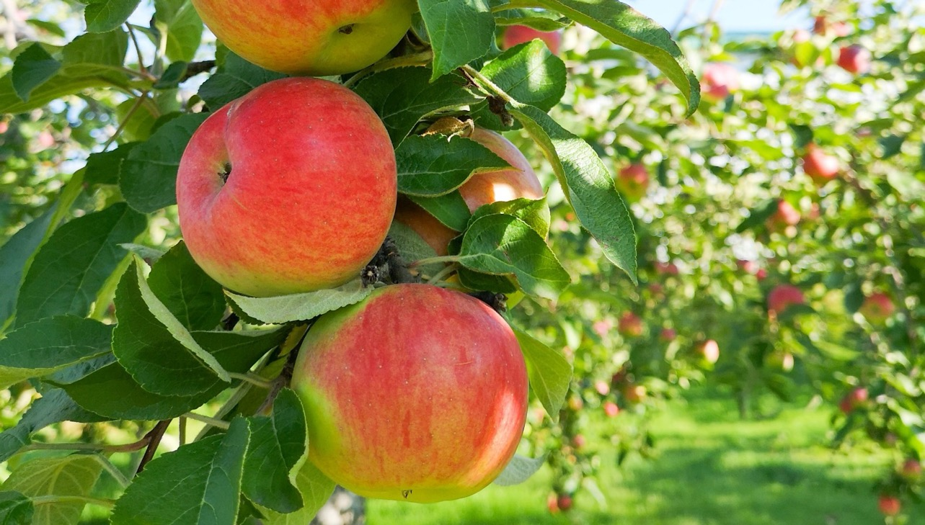
Taste & See
Week 2

Slide 14
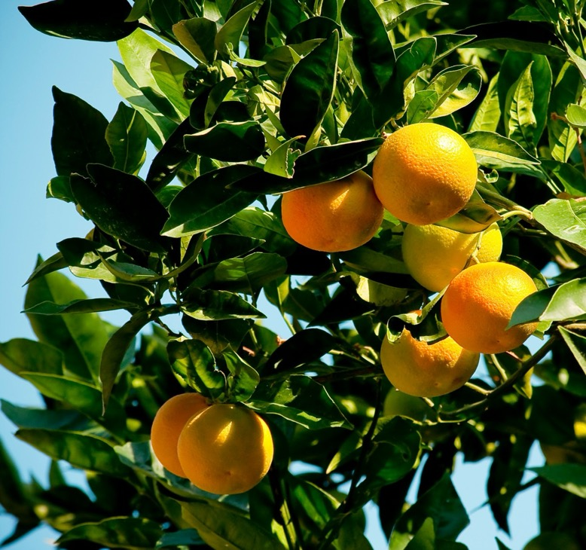
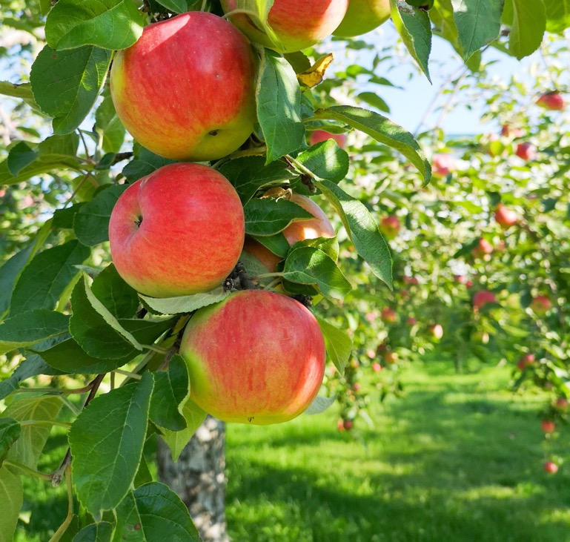
Taste & See
Week 2
The Snake
“Did God really say, ‘You must not eat from any tree in the garden’?”
Genesis 3:1

Slide 15
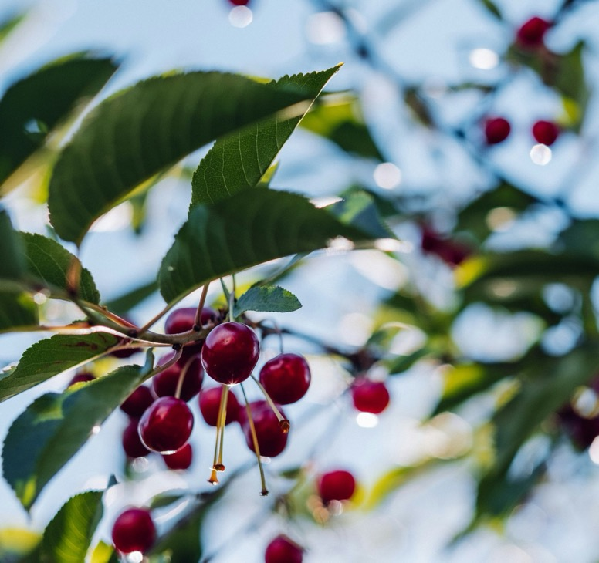
Taste & See
Week 2
God
“You are free to eat from any tree in the garden but you must not eat from the tree of the knowledge of good and evil, for when you eat from it, you will certainly die.”
Genesis 2:17

Slide 16
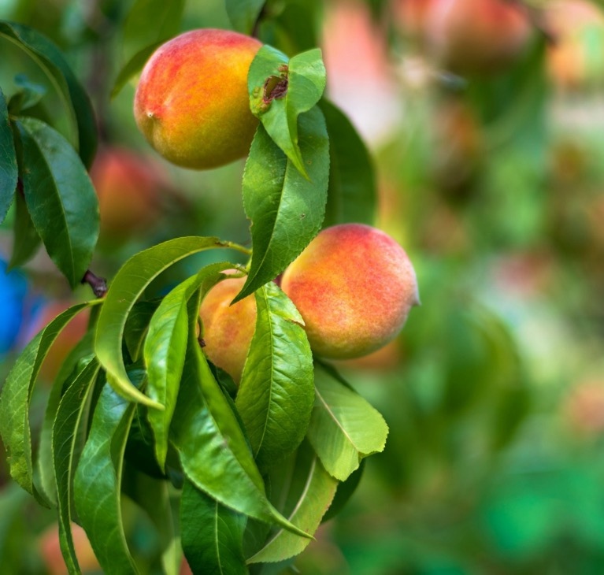
Taste & See
Week 2
Eve
“God said we may eat from any tree in the garden”
Genesis 3:2

Slide 17
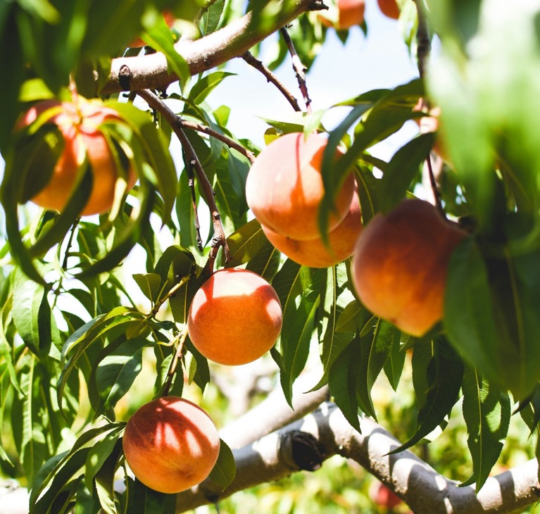
Taste & See
Week 2
The Snake
“You won’t certainly die,” the serpent said to the woman. “For God knows when you eat of it, your eyes will be opened and you will be like God…”
Genesis 3:4-5

Slide 18
Taste & See
Week 2
…when she saw the fruit was good for food and pleasing to the eye and desirable for gaining wisdom, she took some and ate it.
Genesis 3:6

Slide 19
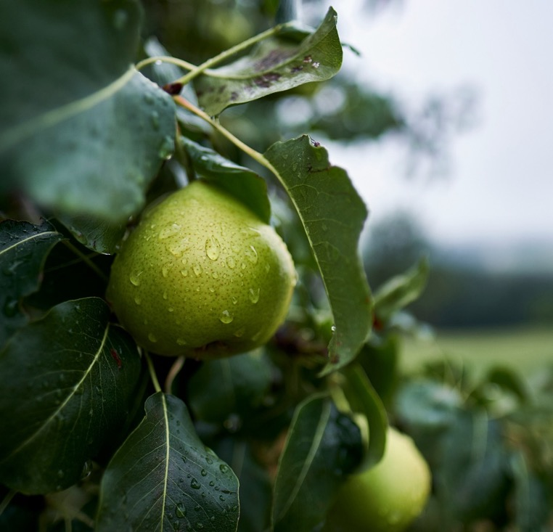
Taste & See
Week 2
The Tree of the Knowledge of
Good and Evil

Slide 20
Taste & See
Week 2
The Snake
“For God knows when you eat of it, your eyes will be opened and you will be like God, knowing good and evil.”
Genesis 3:5

Slide 21
Taste & See
Week 2
Alienated from each other
Then the eyes of both of them were opened, and they realised that they were naked; so they sewed fig leaves together and made coverings for themselves.
Genesis 3:7

Slide 22
Taste & See
Week 2
Alienated from God
Then the man and his wife heard the sound of the LORD God as he was walking in the garden in the cool of the day, and they hid from the LORD God among the trees of the garden. But the LORD God called out to the man, ‘Where are you?’”
Genesis 3:8-9

Slide 23
Taste & See
Week 2
Alienated from Creation
“Cursed is the ground because of you; through painful toil you will eat food from it all the days of your life.”
Genesis 3:17

Slide 24
Taste & See
Week 2
Death…
And the LORD God said, “The man has now become like one of us, knowing good and evil. He must not be allowed to reach out his hand and take also from the tree of life and eat and live forever.”
Genesis 3:22

Slide 25
Taste & See
Week 2
“…a race to whom something happened.”
Jean-Paul Satre

Slide 26
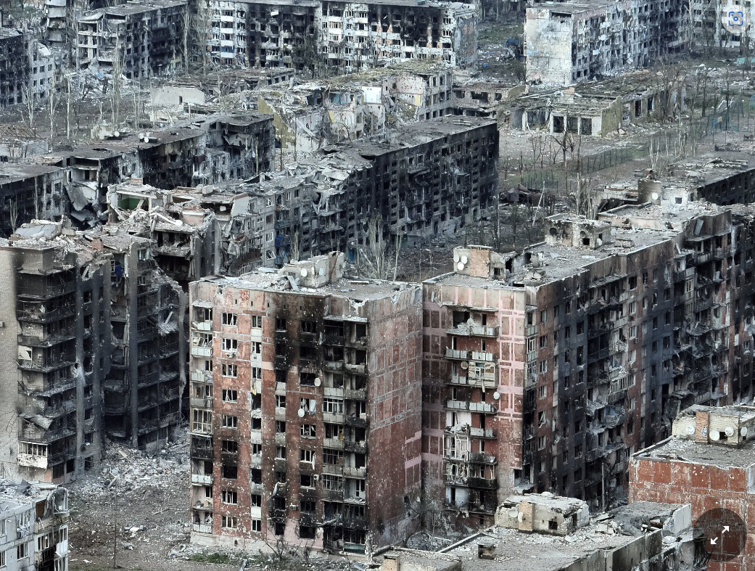
Taste & See
Week 2
Q.
In what ways does this explain the brokenness we see today in the world?

Slide 27
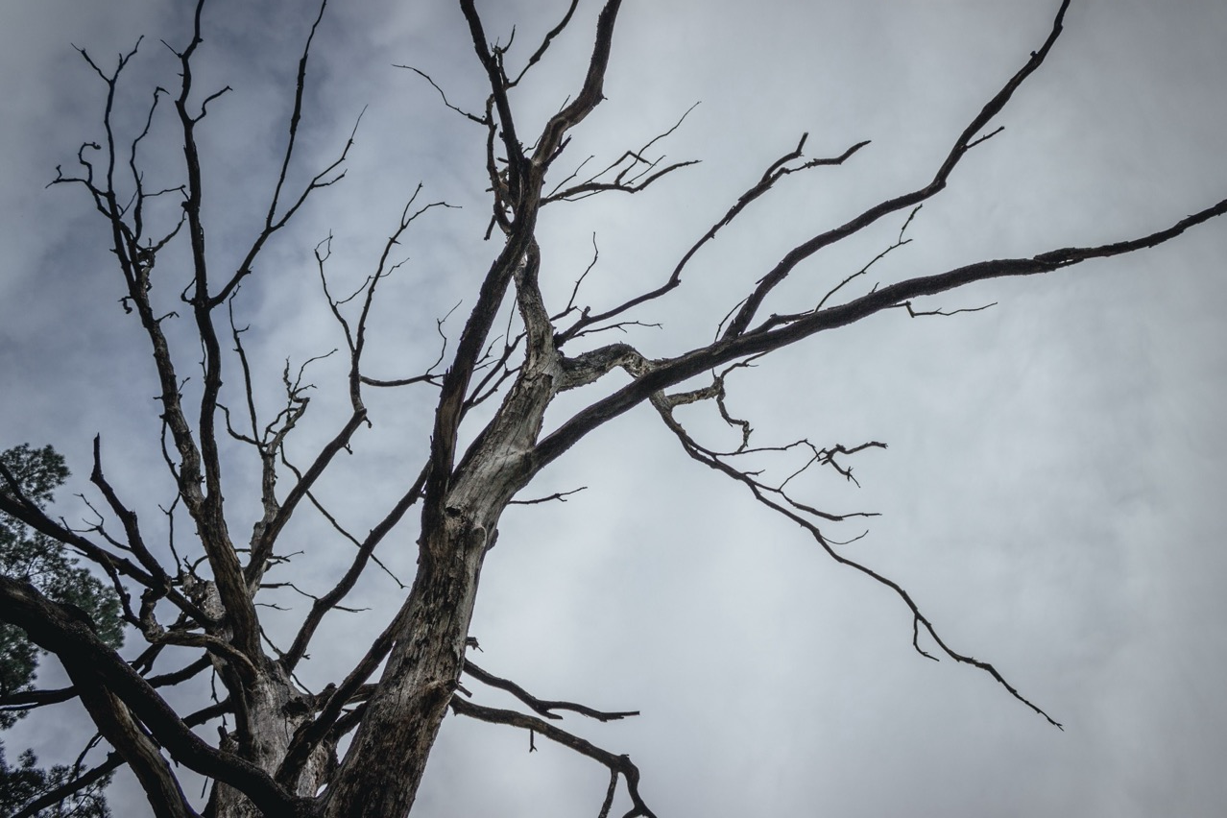
Taste & See
Week 2
Q.
In what ways do we see these things today? (alienation from each other, God and Creation)

Slide 28
Taste & See
Week 2
Sin

Slide 29
Taste & See
Week 2
What is
?
Sin

Slide 30
Taste & See
Week 2
"Everybody worships, the only choice we have is what we worship"
David Foster Wallace ‘This is Water’

Slide 31
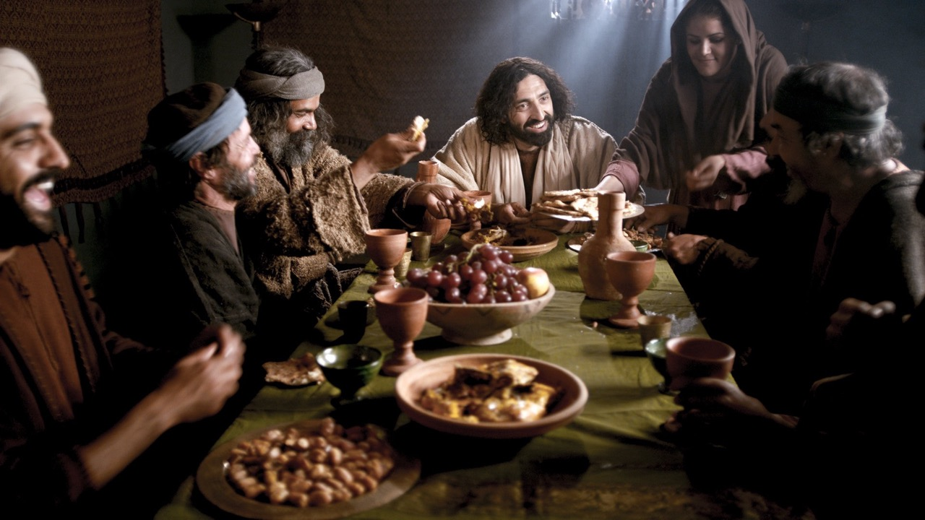
Taste & See
Week 2
‘friend of sinners’
www.LumoProject.com
Notes:
Other religious leaders would never share a meal with people like this. But Jesus and His disciples ate and talked with them.

Slide 32
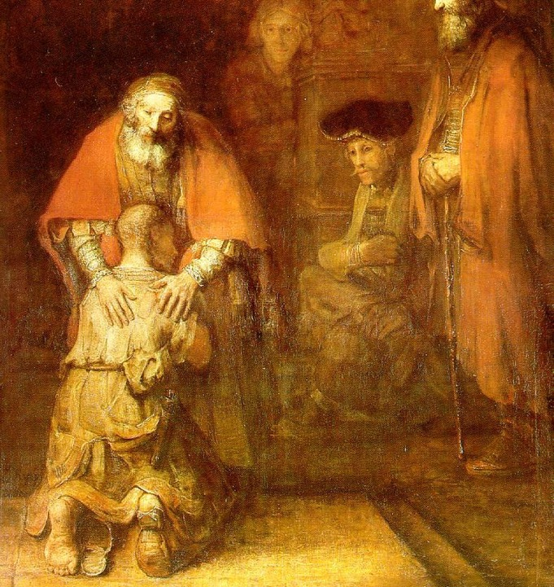
Taste & See
Week 2
The Prodigal Son
Rembrandt
Wikimedia Commons

Slide 33
Taste & See
Week 2
Jesus answers his religious critics
All the tax collectors and sinners were approaching to listen to Him. And the Pharisees and Scribes were complaining “This man welcomes sinners and eats with them!”
So he told them this parable.
Read along on page…

Slide 34
Taste & See
Week 2
“Where are you?”
Genesis 3:9

Slide 35
Week Two
What’s Gone Wrong?

Slide 36
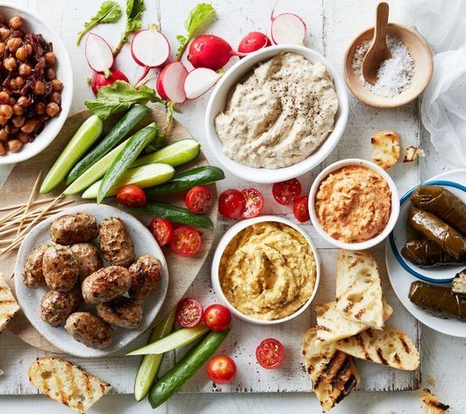
Week Three
The
Great
Rescue

Slide 37
Q.
Take some time to consider:
What was one thing struck you most tonight?
How do these stories deepen our understanding of what’s gone wrong?
Where do you see yourself in these stories?

Slide 38
“Taste and see that the Lord is good; blessed is the one who takes refuge in him.”
Psalm 34:8

Slide 39
EXTRA SLIDES

Slide 40
Exploring the heart of the Christian message of hope over four meals.

Slide 41
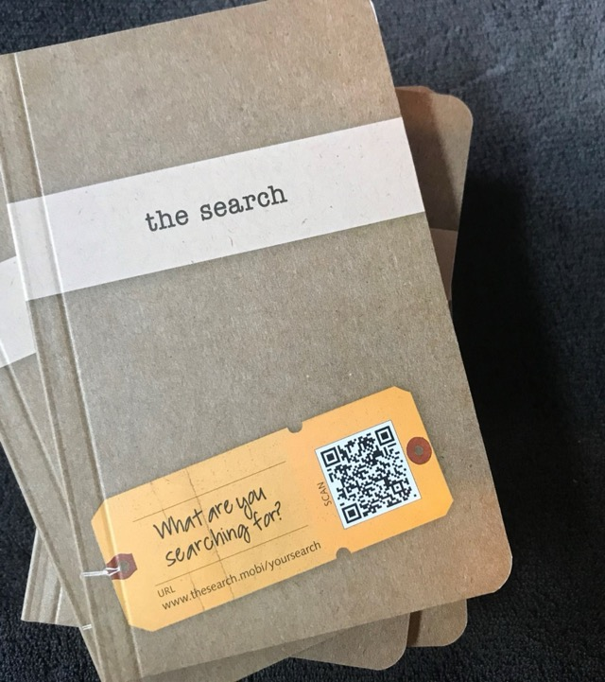
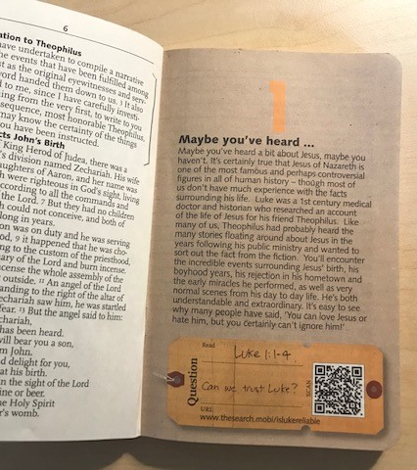

Slide 42
Taste & See
Week 2
The Lost Son
¹¹ Jesus continued: “There was a man who had two sons. ¹² The younger one said to his father, ‘Father, give me my share of the estate.’ So he divided his property between them.
¹³ “Not long after that, the younger son got together all he had, set off for a distant country and there squandered his wealth in wild living. ¹⁴ After he had spent everything, there was a severe famine in that whole country, and he began to be in need. ¹⁵ So he went and hired himself out to a citizen of that country, who sent him to his fields to feed pigs.

Slide 43
Taste & See
Week 2
¹⁶ He longed to fill his stomach with the pods that the pigs were eating, but no one gave him anything.
¹⁷ “When he came to his senses, he said, ‘How many of my father’s hired servants have food to spare, and here I am starving to death! ¹⁸ I will set out and go back to my father and say to him: Father, I have sinned against heaven and against you. ¹⁹ I am no longer worthy to be called your son; make me like one of your hired servants.’ ²⁰ So he got up and went to his father.
Luke 15 : 11 - 20a

Slide 44
Taste & See
Week 2
“But while he was still a long way off, his father saw him and was filled with compassion for him; he ran to his son, threw his arms around him and kissed him.
²¹ “The son said to him, ‘Father, I have sinned against heaven and against you. I am no longer worthy to be called your son.’
²² “But the father said to his servants, ‘Quick! Bring the best robe and put it on him. Put a ring on his finger and sandals on his feet. ²³ Bring the fattened calf and kill it. Let’s have a feast and celebrate. ²⁴ For this son of mine was dead and is alive again; he was lost and is found.’ So they began to celebrate.
Luke 15 : 20b - 24

Slide 45
Taste & See
Week 2
²⁵ “Meanwhile, the older son was in the field. When he came near the house, he heard music and dancing. ²⁶ So he called one of the servants and asked him what was going on. ²⁷ ‘Your brother has come,’ he replied, ‘and your father has killed the fattened calf because he has him back safe and sound.’

Slide 46
Taste & See
Week 2
²⁸ “The older brother became angry and refused to go in. So his father went out and pleaded with him. ²⁹ But he answered his father, ‘Look! All these years I’ve been slaving for you and never disobeyed your orders. Yet you never gave me even a young goat so I could celebrate with my friends. ³⁰ But when this son of yours who has squandered your property with prostitutes comes home, you kill the fattened calf for him!’
³¹ “‘My son,’ the father said, ‘you are always with me, and everything I have is yours. ³² But we had to celebrate and be glad, because this brother of yours was dead and is alive again; he was lost and is found.’”
Luke 15 : 25 - 35

Slide 47
Taste & See
Week 2
The Lost Son
¹¹ Jesus continued: “There was a man who had two sons. ¹² The younger one said to his father, ‘Father, give me my share of the estate.’ So he divided his property between them.
¹³ “Not long after that, the younger son got together all he had, set off for a distant country and there squandered his wealth in wild living. ¹⁴ After he had spent everything, there was a severe famine in that whole country, and he began to be in need. ¹⁵ So he went and hired himself out to a citizen of that country, who sent him to his fields to feed pigs.

Slide 48
Taste & See
Week 2
¹⁶ He longed to fill his stomach with the pods that the pigs were eating, but no one gave him anything.
¹⁷ “When he came to his senses, he said, ‘How many of my father’s hired servants have food to spare, and here I am starving to death! ¹⁸ I will set out and go back to my father and say to him: Father, I have sinned against heaven and against you. ¹⁹ I am no longer worthy to be called your son; make me like one of your hired servants.’ ²⁰ So he got up and went to his father.
Luke 15 : 11 - 20a

Slide 49
Taste & See
Week 2
“But while he was still a long way off, his father saw him and was filled with compassion for him; he ran to his son, threw his arms around him and kissed him.
²¹ “The son said to him, ‘Father, I have sinned against heaven and against you. I am no longer worthy to be called your son.’
²² “But the father said to his servants, ‘Quick! Bring the best robe and put it on him. Put a ring on his finger and sandals on his feet. ²³ Bring the fattened calf and kill it. Let’s have a feast and celebrate. ²⁴ For this son of mine was dead and is alive again; he was lost and is found.’ So they began to celebrate.
Luke 15 : 20b - 24

Slide 50
Taste & See
Week 2
²⁵ “Meanwhile, the older son was in the field. When he came near the house, he heard music and dancing. ²⁶ So he called one of the servants and asked him what was going on. ²⁷ ‘Your brother has come,’ he replied, ‘and your father has killed the fattened calf because he has him back safe and sound.’

Slide 51
Taste & See
Week 2
²⁸ “The older brother became angry and refused to go in. So his father went out and pleaded with him. ²⁹ But he answered his father, ‘Look! All these years I’ve been slaving for you and never disobeyed your orders. Yet you never gave me even a young goat so I could celebrate with my friends. ³⁰ But when this son of yours who has squandered your property with prostitutes comes home, you kill the fattened calf for him!’
³¹ “‘My son,’ the father said, ‘you are always with me, and everything I have is yours. ³² But we had to celebrate and be glad, because this brother of yours was dead and is alive again; he was lost and is found.’”
Luke 15 : 25 - 35

