Slide 1
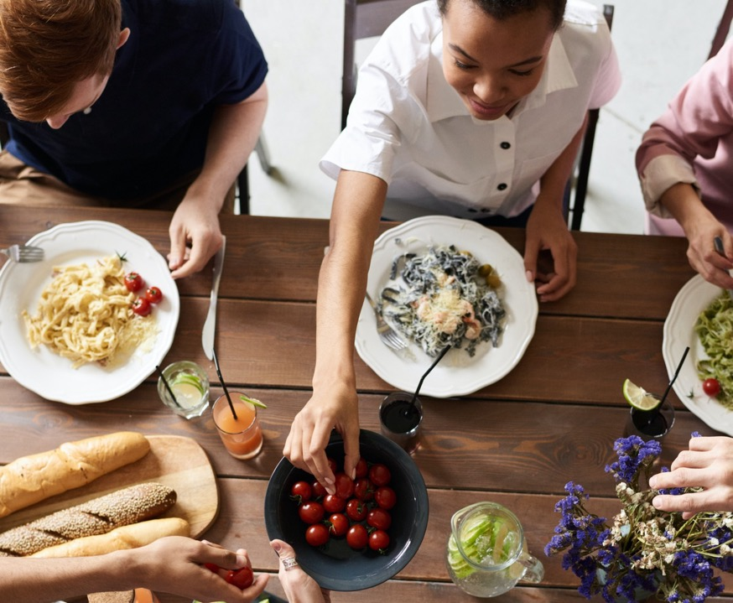
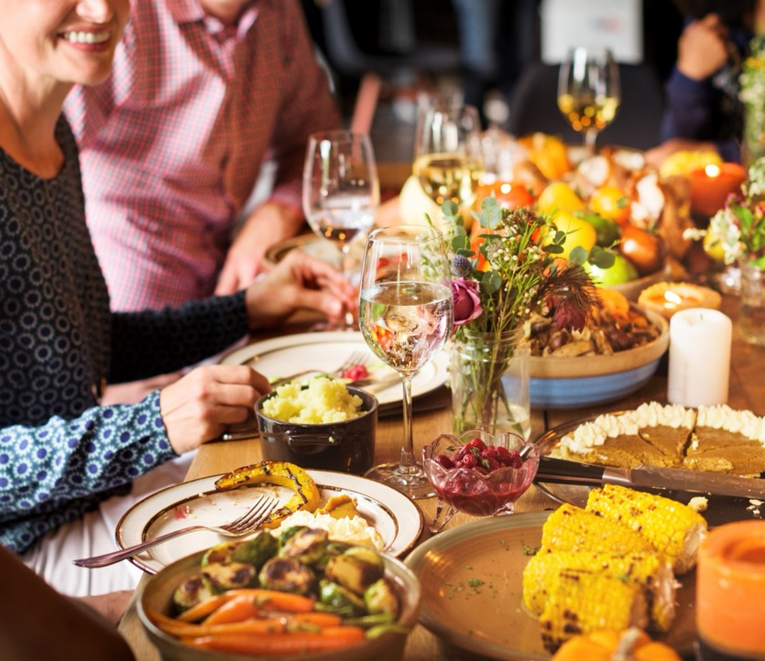
Exploring the heart of the Christian message of hope over four meals.

Slide 2
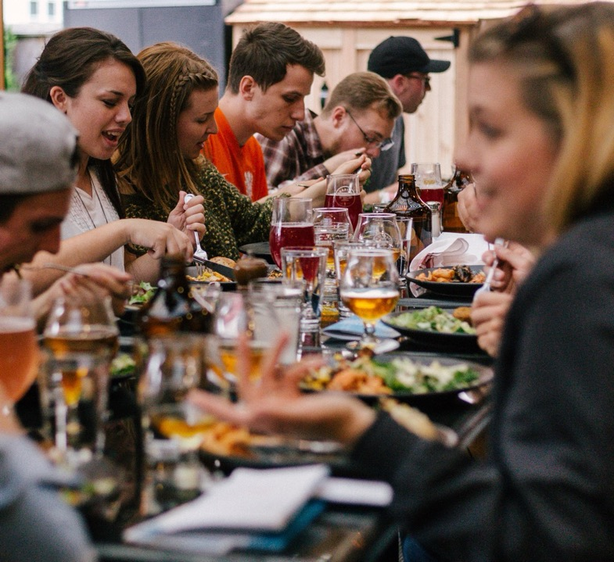
Taste & See
Week 1
Welcome!
To 4 unique meals over 4 weeks exploring 4 big ideas about God around the table.

Slide 3
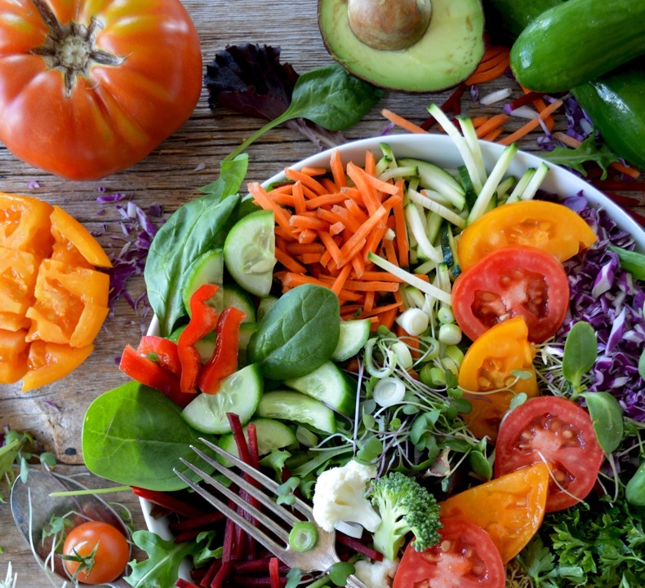
Week One
It Was Good!

Slide 4
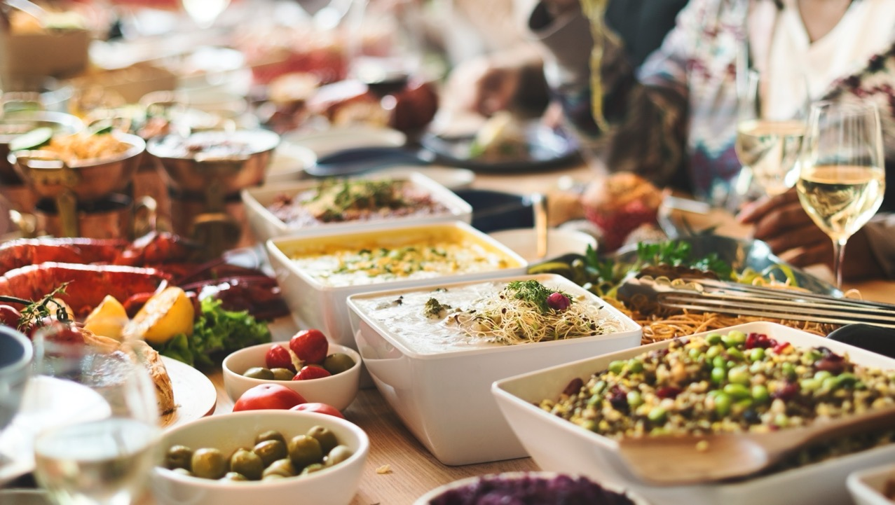
Taste & See
Week 1
Q.
If you had to choose one type of food to eat for the rest of your life, what would it be and why?

Slide 5
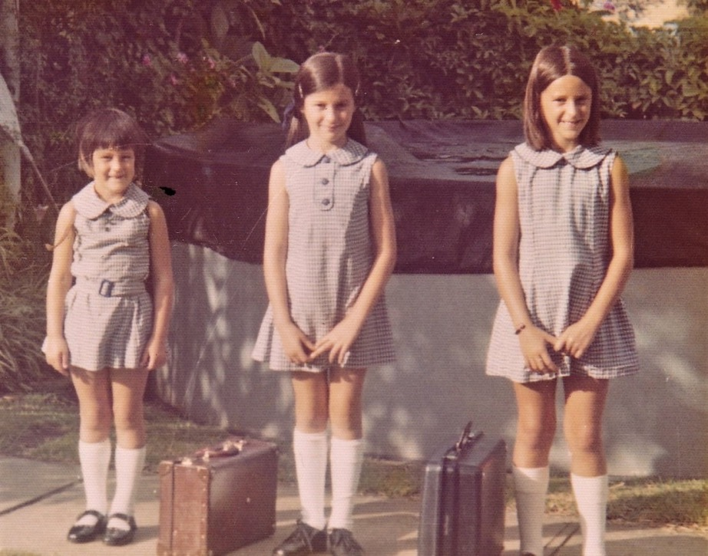
Taste & See
Week 1
A bit about me…
(Swap in your own photo here!)

Slide 6
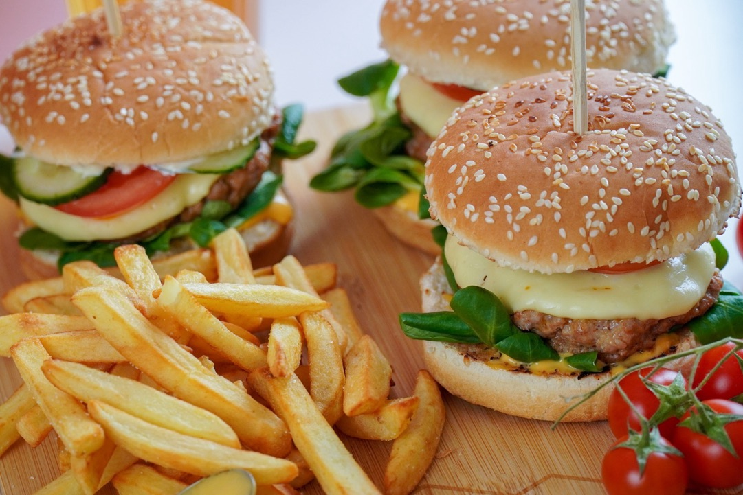
Week Two
What’s Gone Wrong?

Slide 7
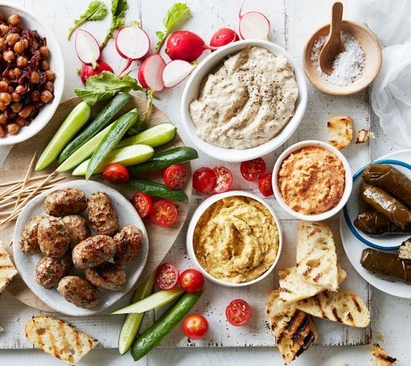
Week Three
The
Great
Rescue

Slide 8
Week Four
Future Hope

Slide 9
Week 1
Taste & See
Week 1
Optional section on the Bible – here or week 3

Slide 10
Week One
It Was Good!

Slide 11
Then God said, “I give you every seed-bearing plant on the face of the whole earth and every tree that has fruit with seed in it. They will be yours for food.
And to all the beasts of the earth and all the birds in the sky and all the creatures that move along the ground—everything that has the breath of life in it—I give every green plant for food.” And it was so.
God saw all that he had made, and it was very good.
Genesis 1:29-30

Slide 12
Taste & See
Week 1
GOD

Slide 13
Week 1
Taste & See
Week 1
Taste & See
GOD
In the beginning…

Slide 14
Week 1
Taste & See
Week 1
Taste & See
GOD
In the beginning God created the heavens and the earth. Genesis 1:1

Slide 15
Taste & See
Week 1

Slide 16
Week 1
Taste & See
Week 1
Taste & See
The God Who
Creates...

Slide 17
Taste & See
Week 1
CREATION

Slide 18
Taste & See
Now the earth was formless and empty, darkness was over the surface of the deep, and the Spirit of God was hovering over the waters.
And God said, “Let there be light,” and there was light. 4 God saw that the light was good, and he separated the light from the darkness. 5 God called the light “day,” and the darkness he called “night.” And there was evening, and there was morning—the first day.
Genesis 1:2-5

Slide 19
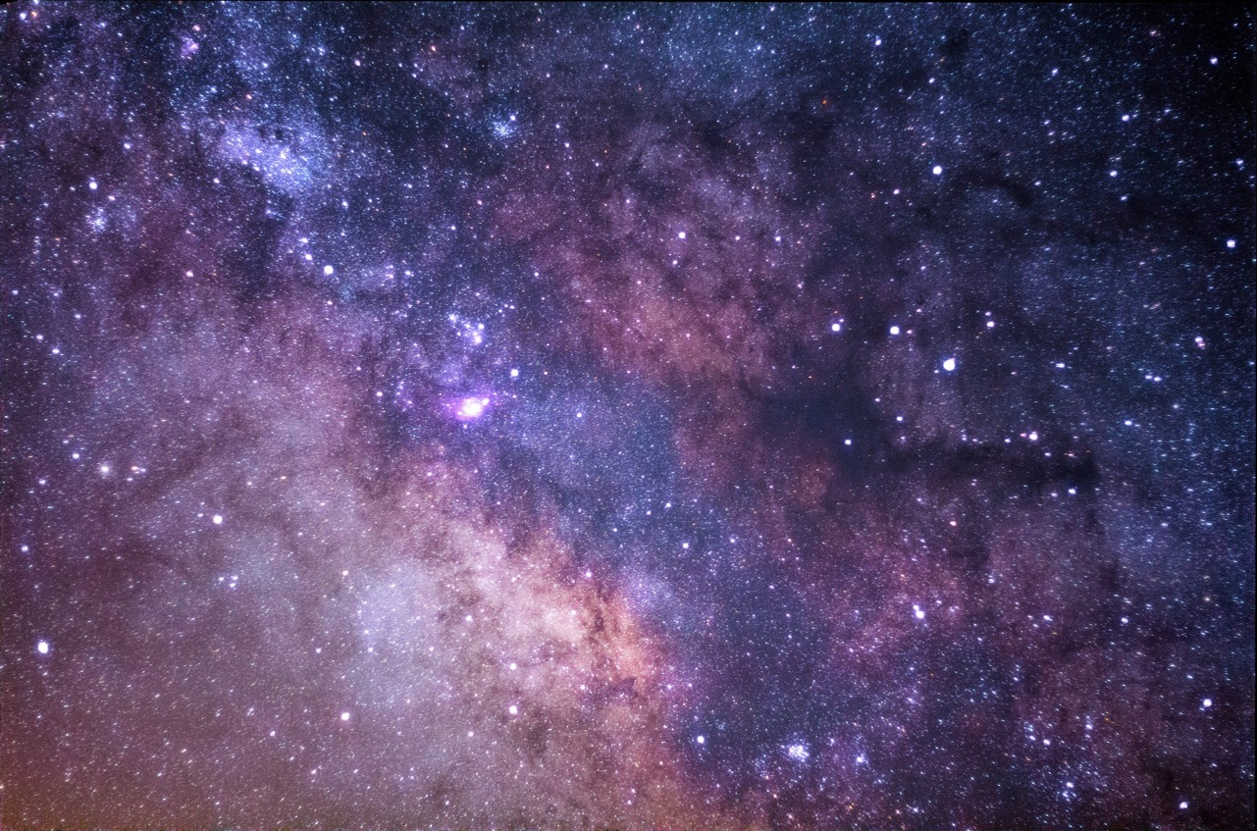
Taste & See
Week 1
And God saw that it was good.
Genesis 1

Slide 20
Taste & See
Week 1
Q.
Where do you see examples of design, beauty and order in the universe?

Slide 21
Week 1
Taste & See
Week 1
Taste & See

Slide 22
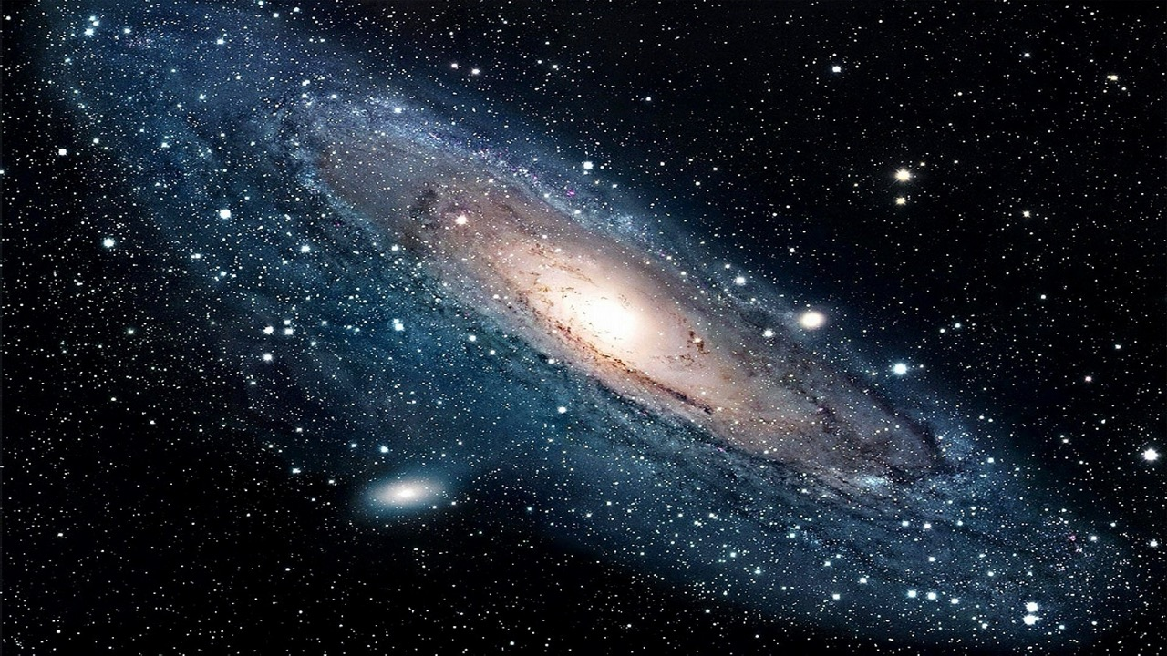
Week 1
Taste & See
Week 1
Taste & See

Slide 23
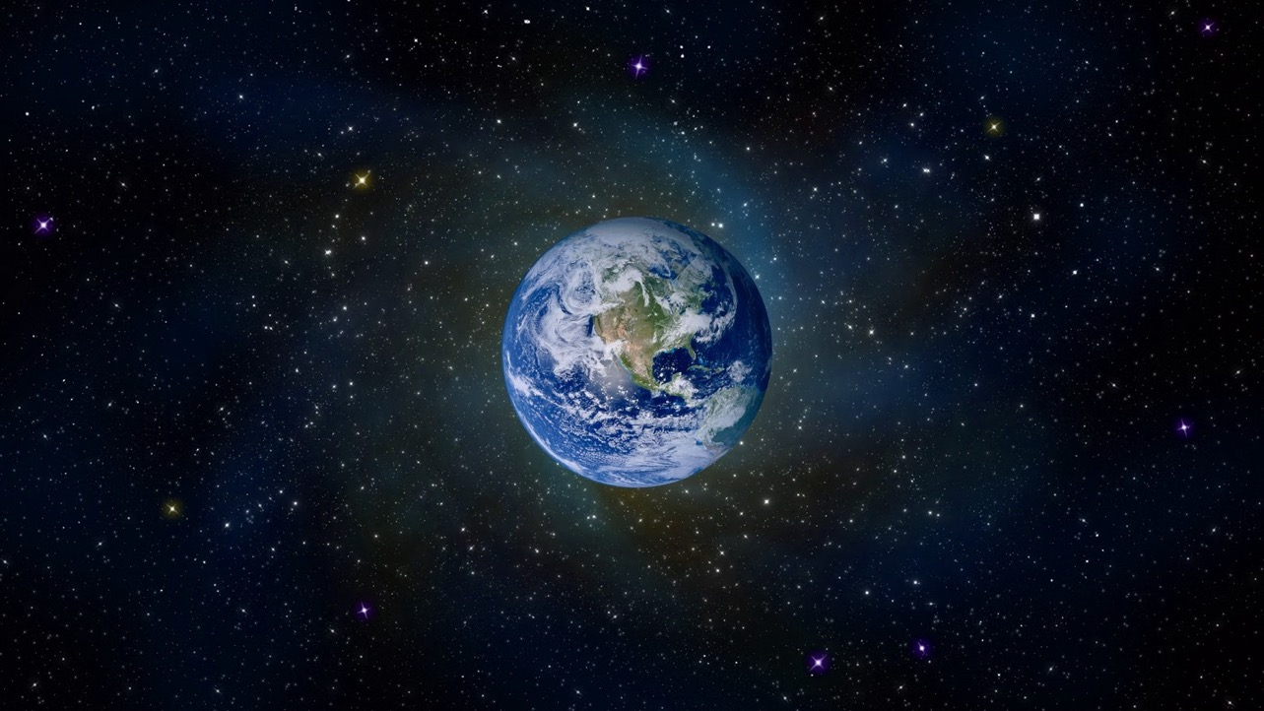
Week 1
Taste & See
Week 1
Taste & See

Slide 24
Taste & See
Week 1

Slide 25
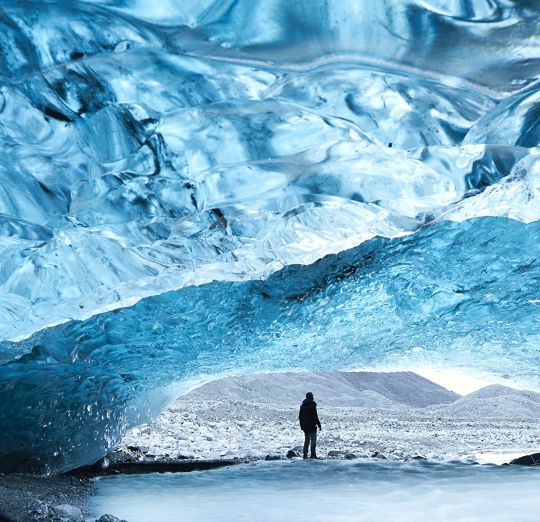
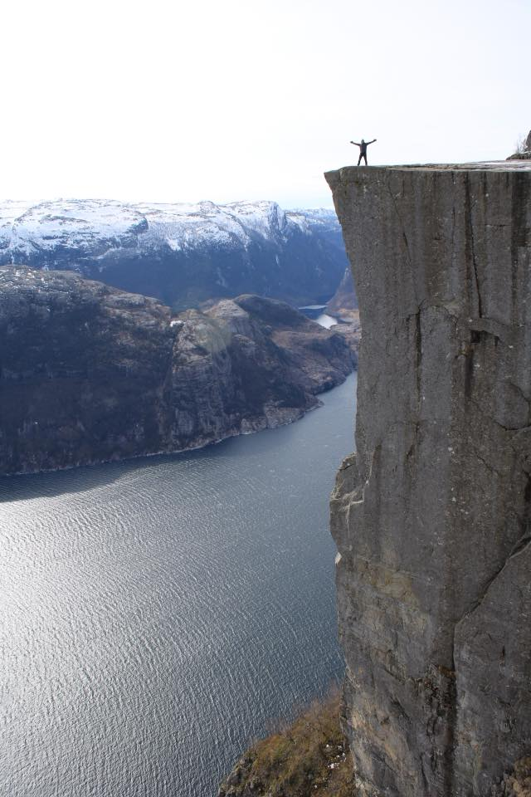
Taste & See
Week 1

Slide 26
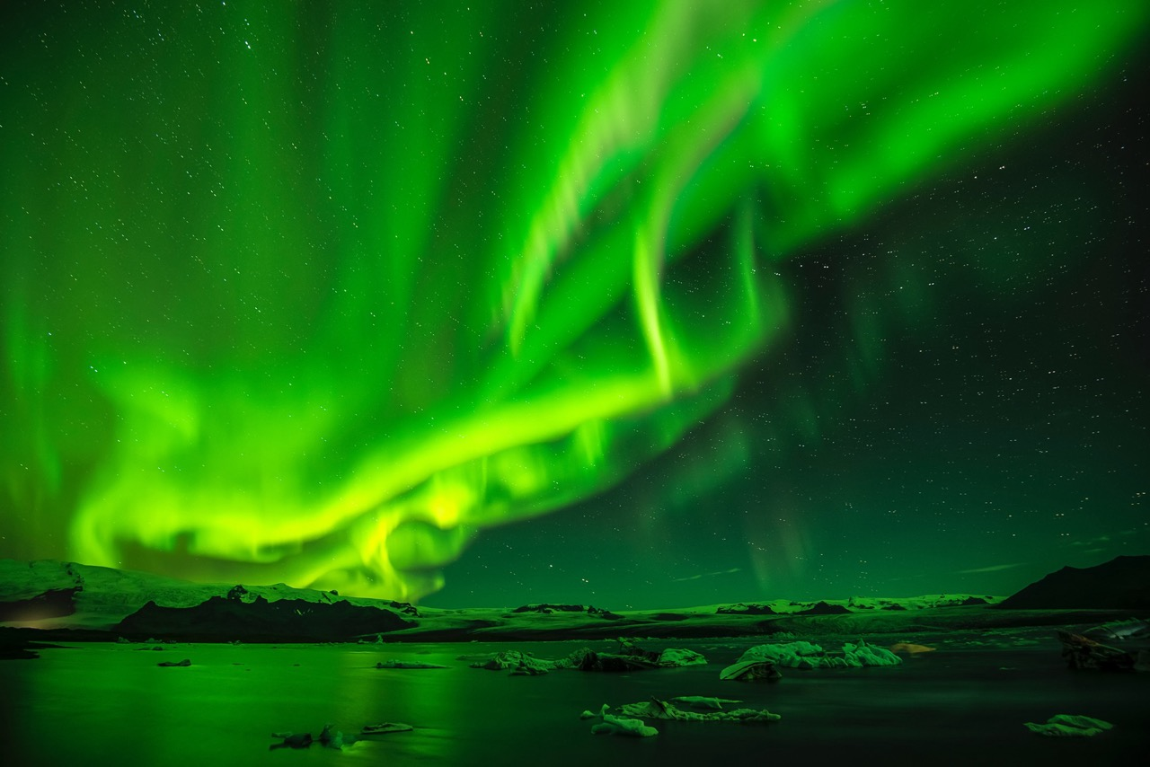
Taste & See
Week 1

Slide 27
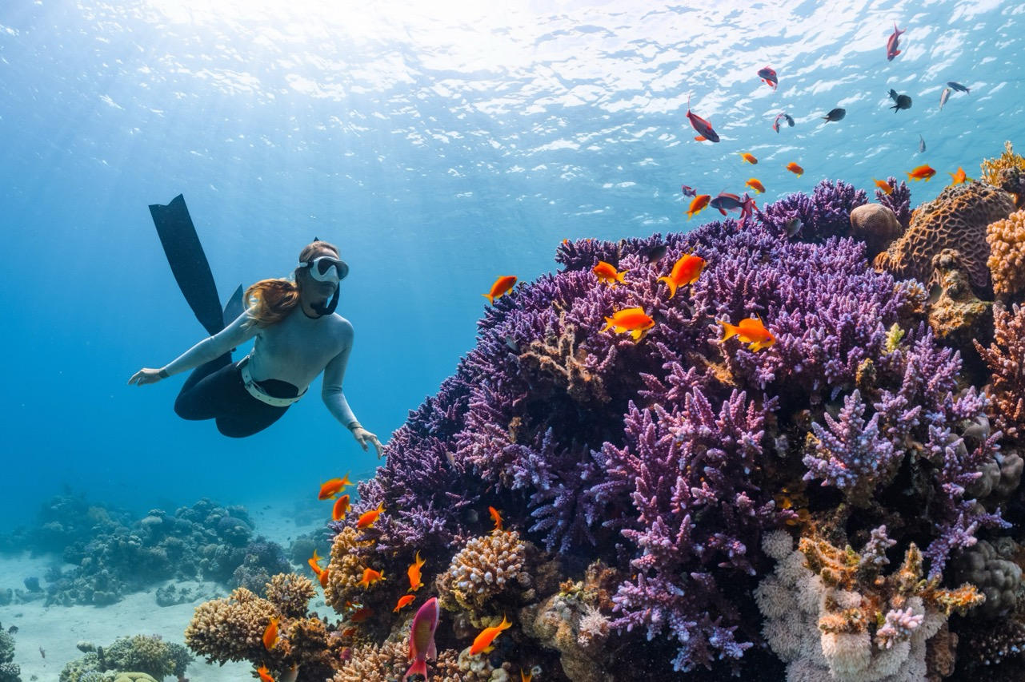
Taste & See
Week 1

Slide 28
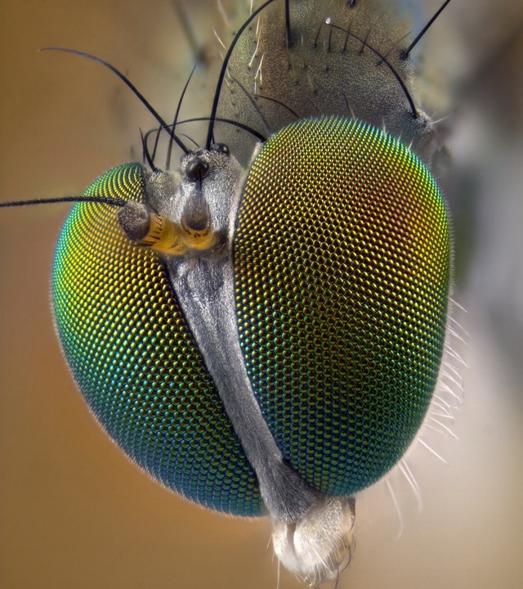
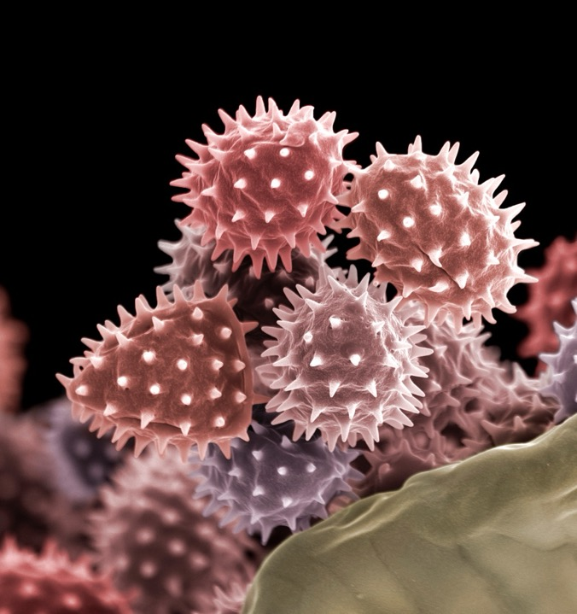
Taste & See
Week 1

Slide 29
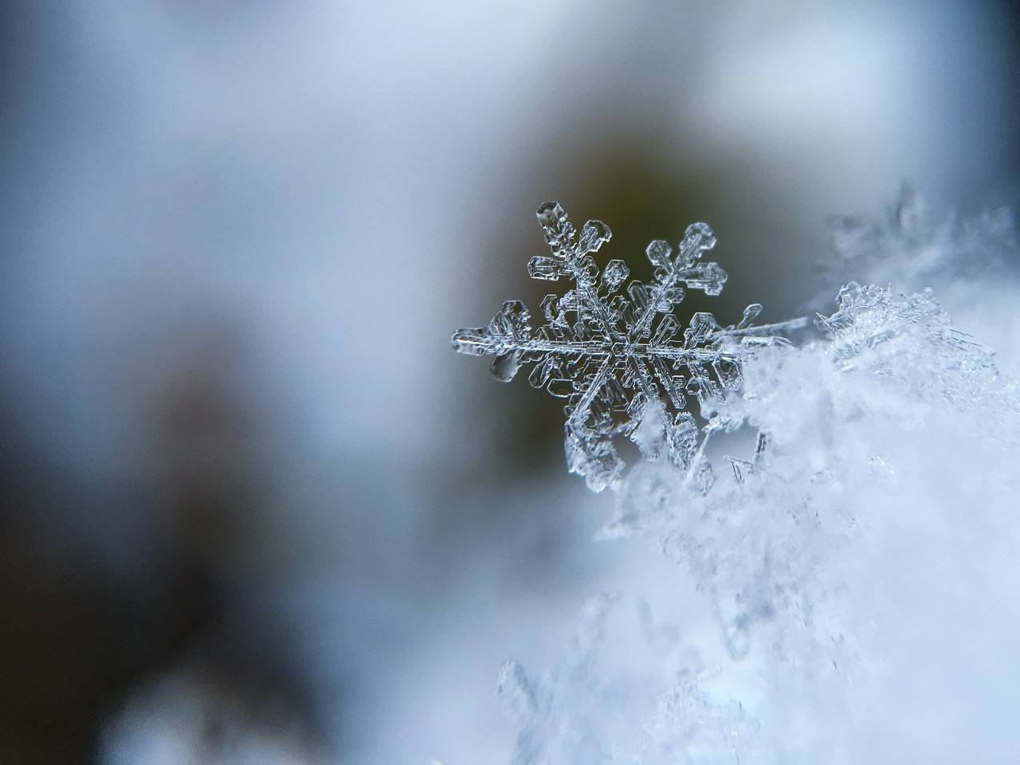
Taste & See
Week 1

Slide 30
Taste & See
Week 1

Slide 31
Taste & See
Week 1

Slide 32
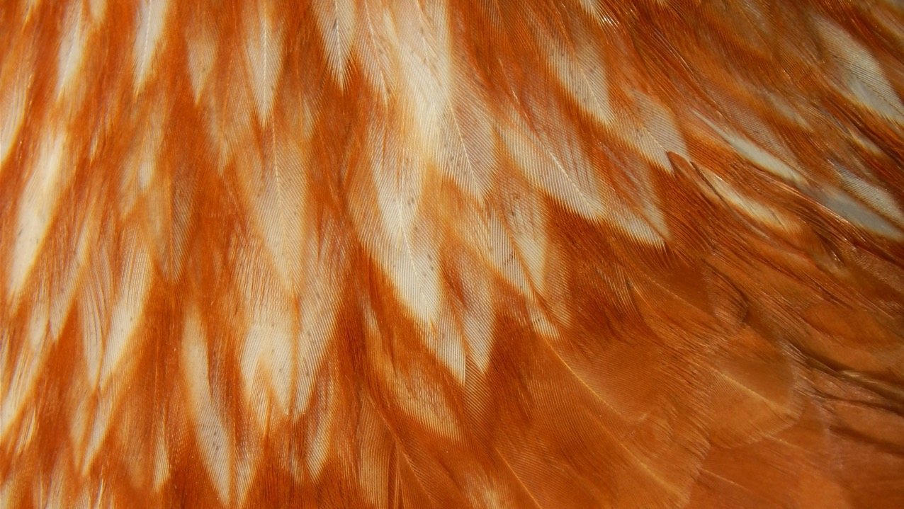
Taste & See
Week 1

Slide 33
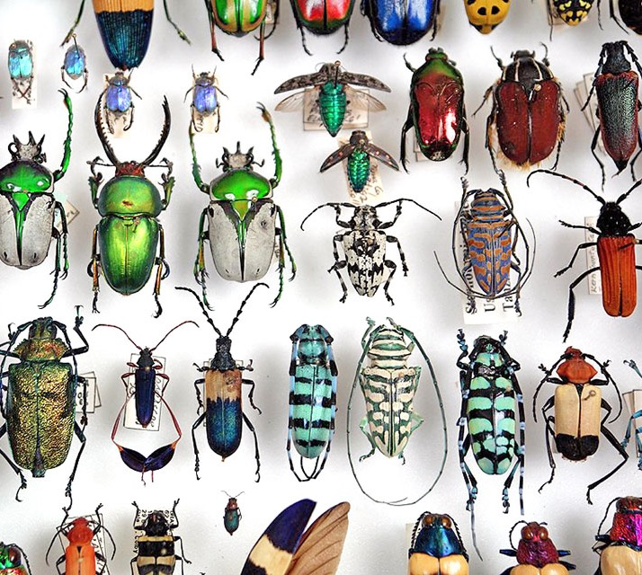
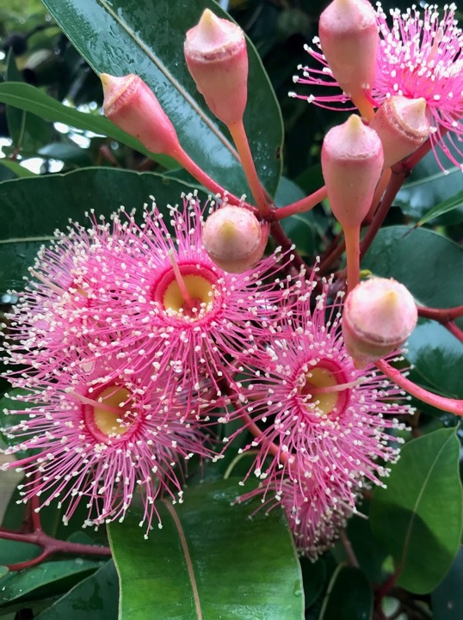
Taste & See
Week 1

Slide 34
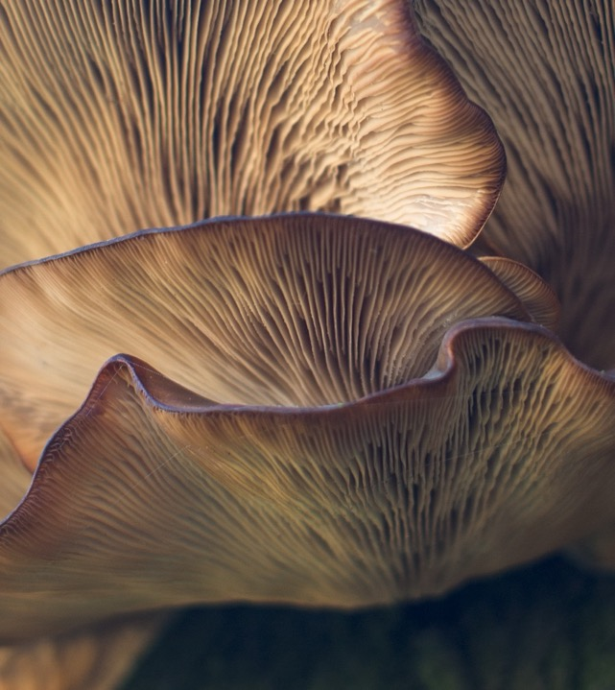
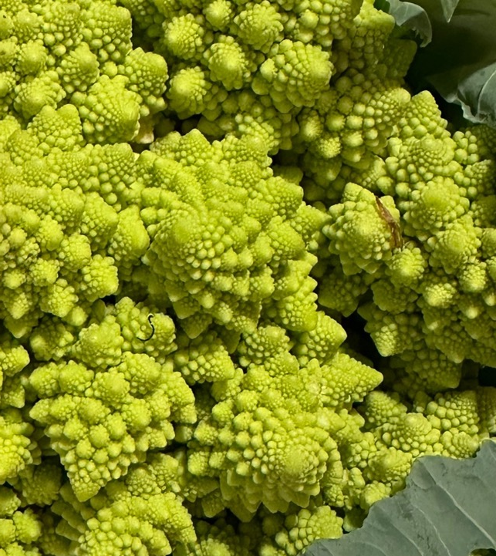
Taste & See
Week 1

Slide 35
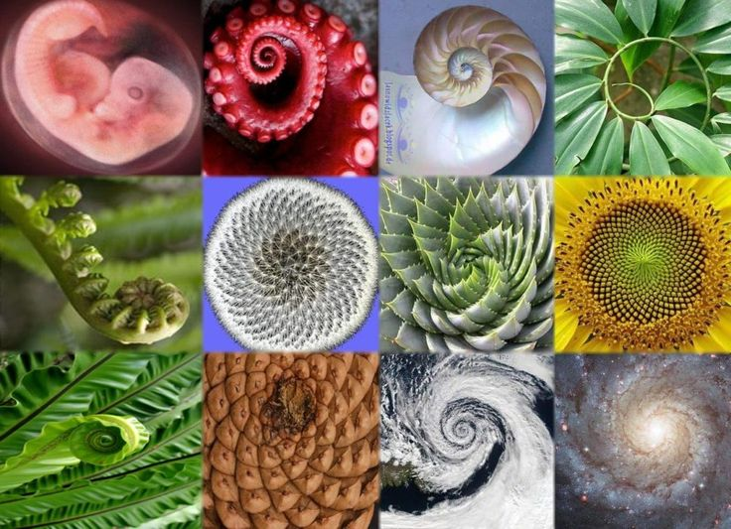
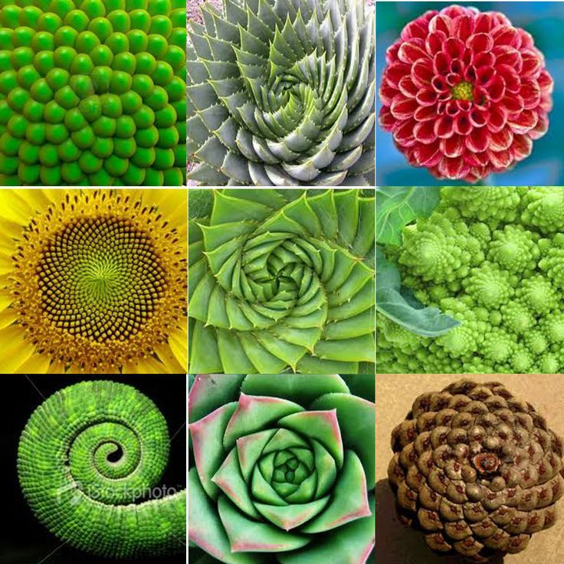
Taste & See
Week 1

Slide 36
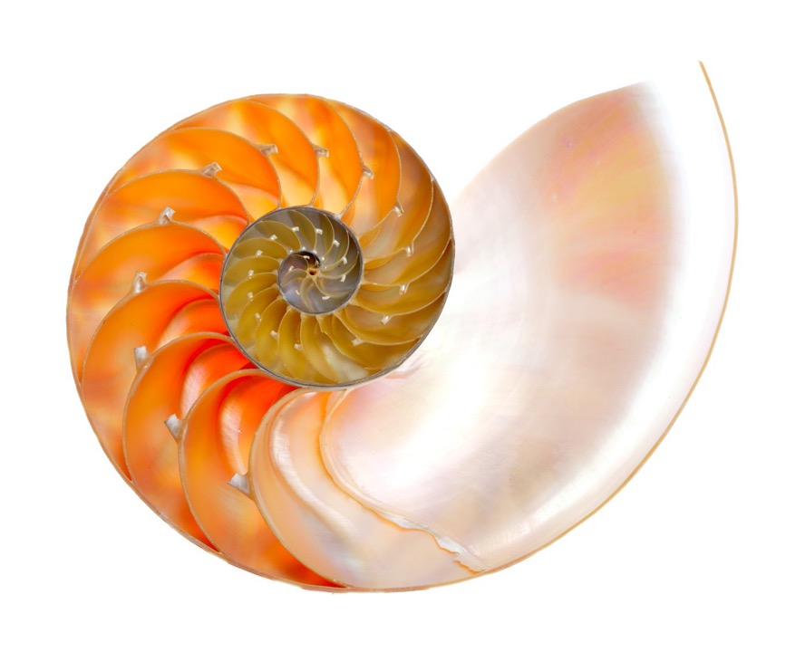
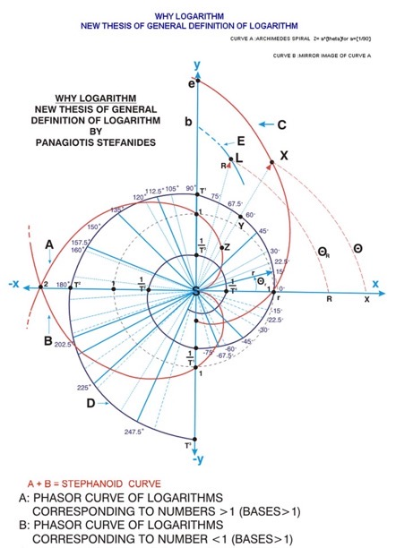
Taste & See
Week 1

Slide 37
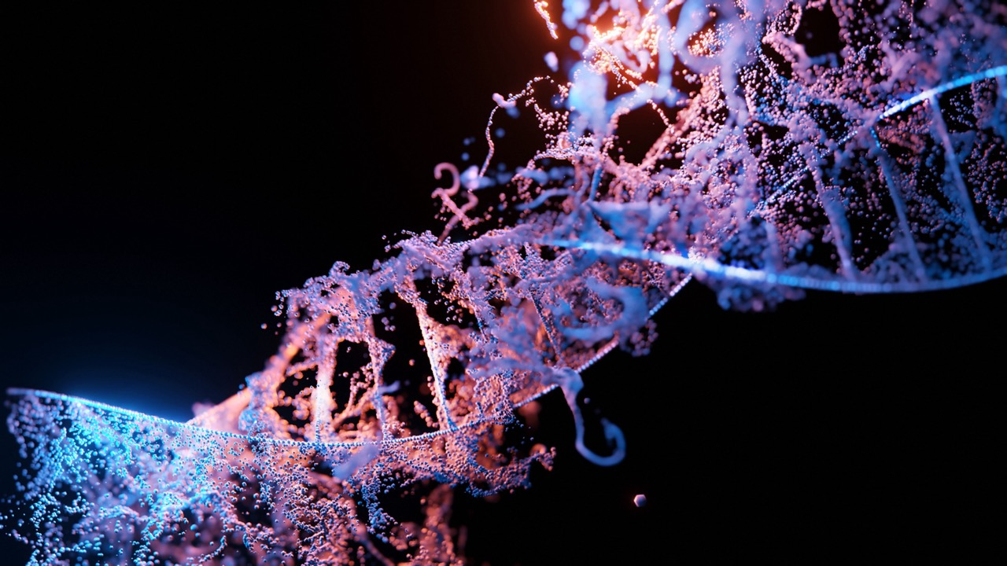
Taste & See
Week 1

Slide 38
Taste & See
Week 1
The heavens declare the glory of God; the skies proclaim the work of his hands. Day after day they pour forth speech; night after night they reveal knowledge.
Psalm 19

Slide 39
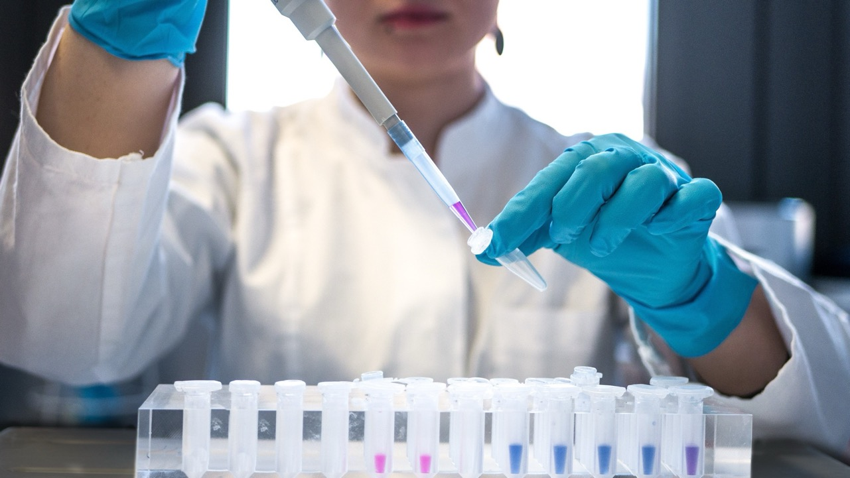
Taste & See
Week 1
So, what about science?

Slide 40
Taste & See
Week 1
Three Approaches
They are saying different things about the same thing.

Slide 41
Taste & See
Week 1
Three Approaches
Bible
OR
Science
They are saying different things about the same thing.

Slide 42
Taste & See
Week 1
Three Approaches
Bible
OR
Science
They are saying different things about the same thing.
They are saying the same thing about the same thing.

Slide 43
Taste & See
Week 1
Three Approaches
Bible
OR
Science
They are saying different things about the same thing.
They are saying the same thing about the same thing.
Bible
=
Science

Slide 44
Taste & See
Week 1
Three Approaches
Bible
OR
Science
They are saying different things about the same thing.
They are saying the same thing about the same thing.
Bible
=
Science
They are saying different things.

Slide 45
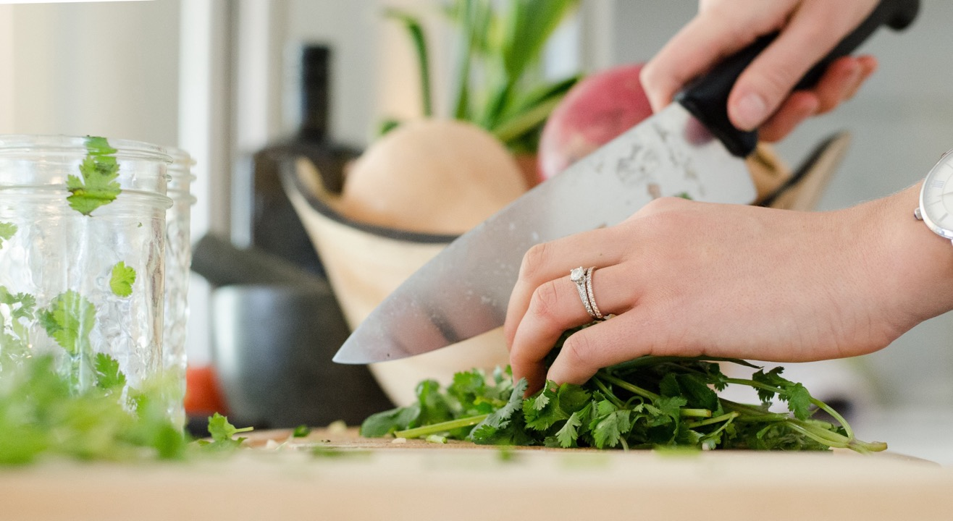
Taste & See
Week 1
Either Food Tech or Mona Lisa illustration

Slide 46
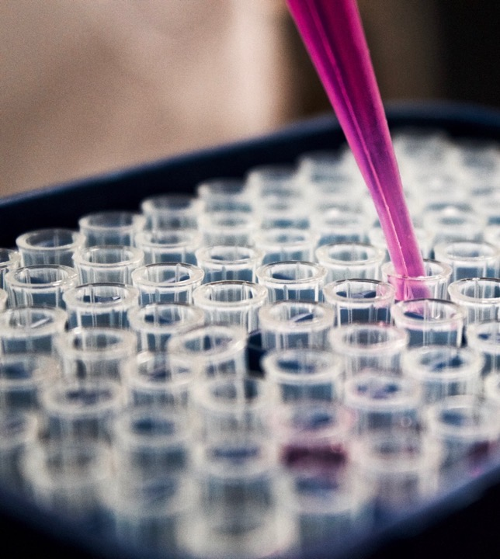
Taste & See
Week 1
Either Food Tech or Mona Lisa illustration

Slide 47
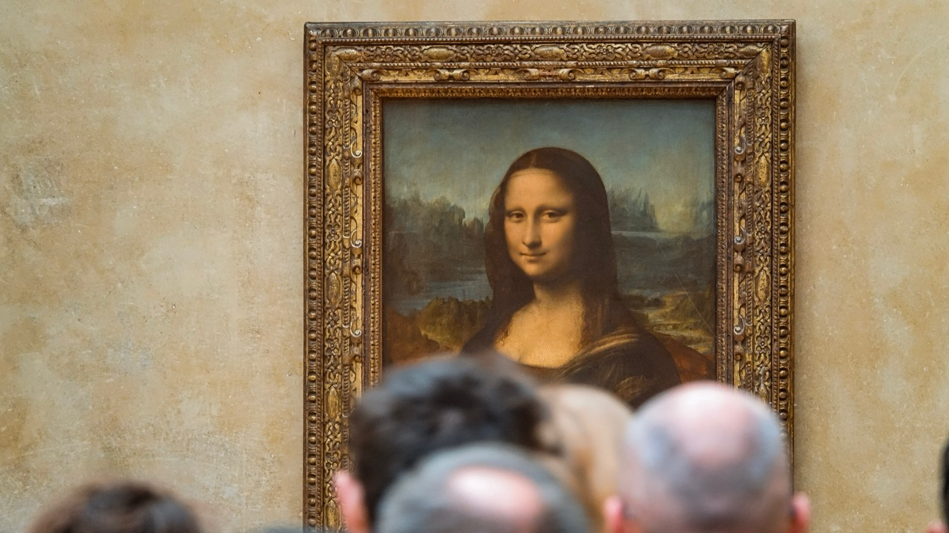
Taste & See
Week 1
Either Mona Lisa or Food Tech illustration

Slide 48
Taste & See
Week 1
Three Approaches
Bible
OR
Science
They are saying different things about the same thing.
They are saying the same thing about the same thing.
Bible
=
Science
Bible
AND
Science
They are saying different things.

Slide 49
Taste & See
Week 1
VIDEO

Slide 50
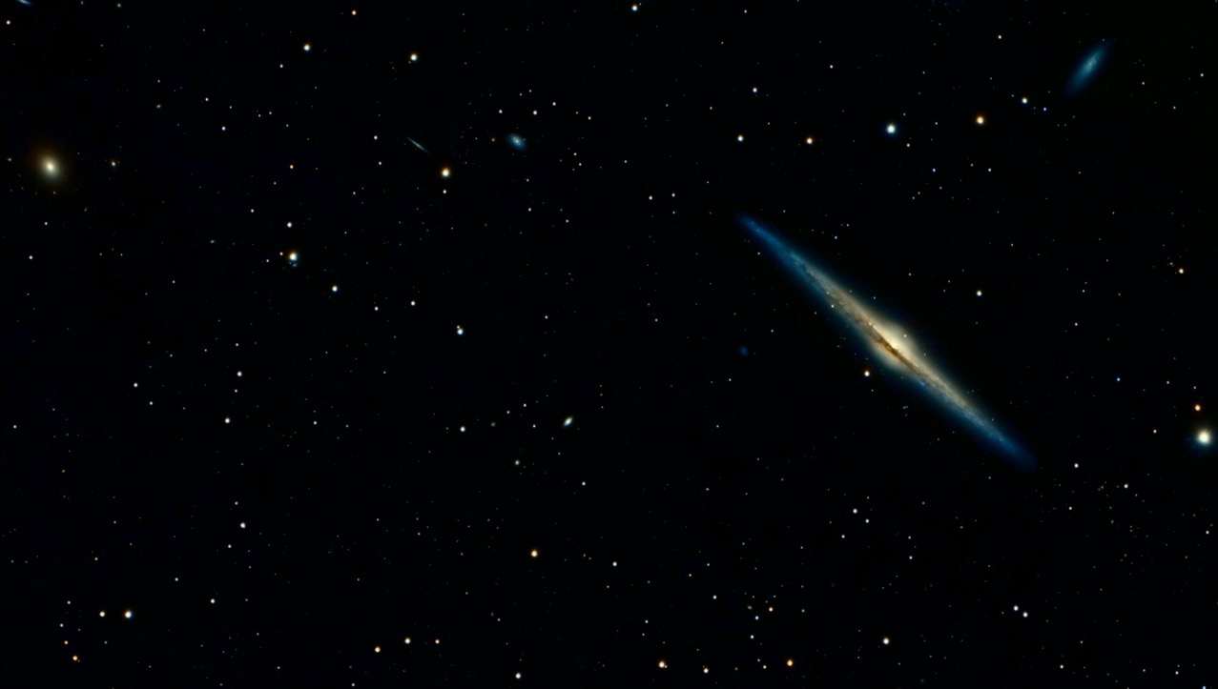
Week 1
Taste & See
Week 1
Taste & See
Q.
“…even if [multiverses] turn out to be correct, what does it mean?” – Brian Cox

Slide 51
Taste & See
Week 1
Scientific discoveries – “an opportunity to worship.”
Francis Collins
Physician/ Geneticist Head of Human Genome Project “The Language of God: A Scientist Presents Evidence for Belief”

Slide 52
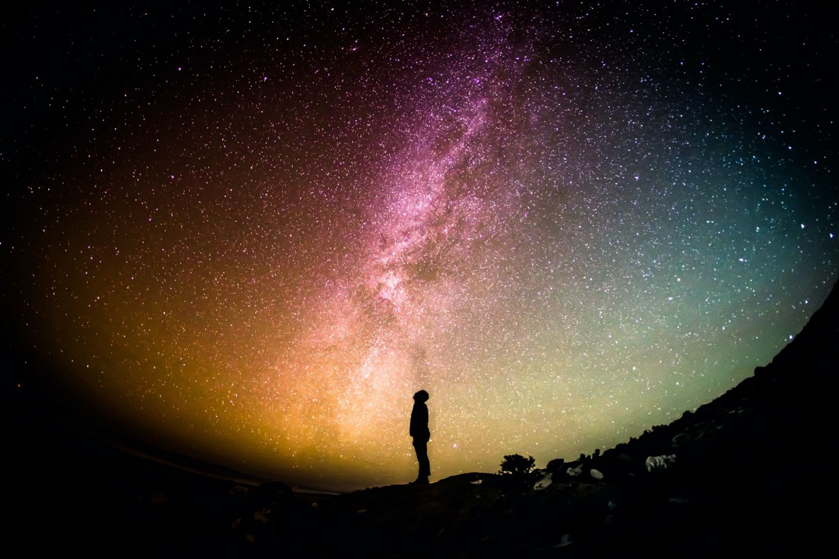
Taste & See
Week 1
“Science can help us see God more clearly… I see a richness and beauty in what science can tell us about the earth and the universe beyond what one might expect from a purely mechanical system.
I think that superabundance is an expression of who God is. He’s beyond his creation and separate from it. You cant find God in a plant but I think you can find his fingerprints.”
Dr Adrian Paterson
CEO ANSTO
It Was Good

Slide 53
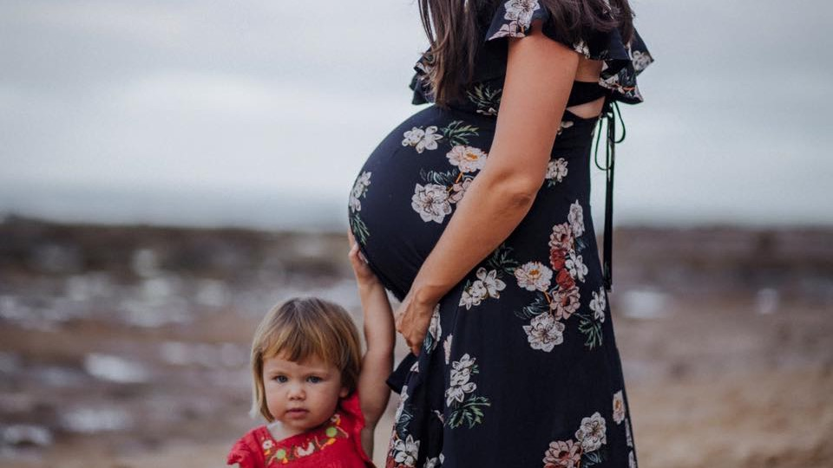
Taste & See
Week 1
Wonder & Meaning

Slide 54
Taste & See
Week 1
Q.
Where do your ideas about God come from?
Image of lots of different faces

Slide 55
Taste & See
Week 1
HUMANITY

Slide 56
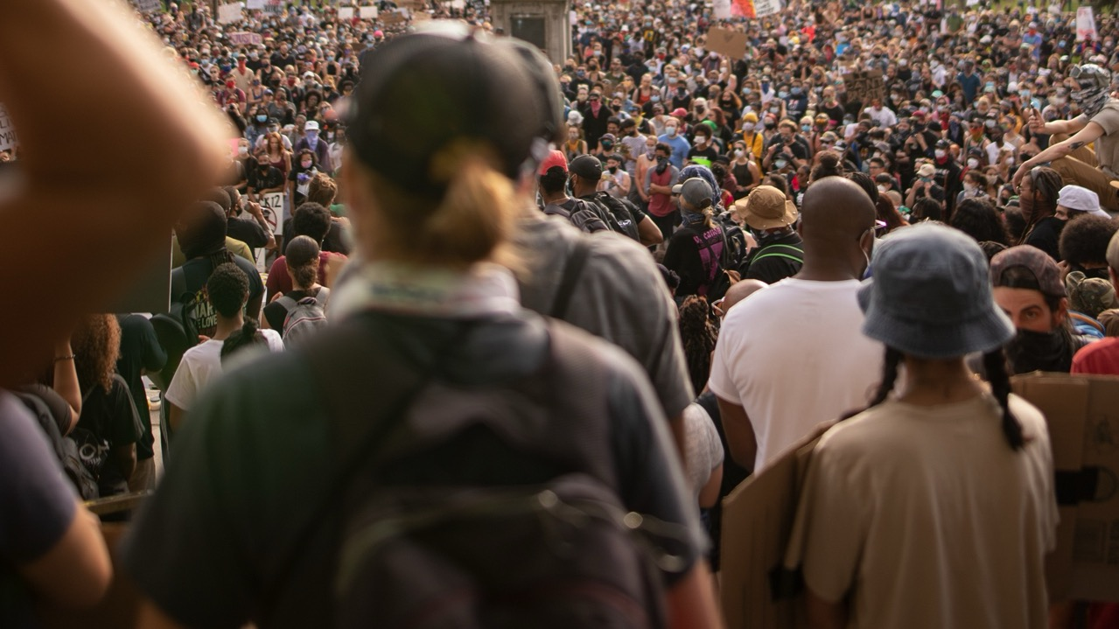
Taste & See
Week 1
HUMANITY

Slide 57
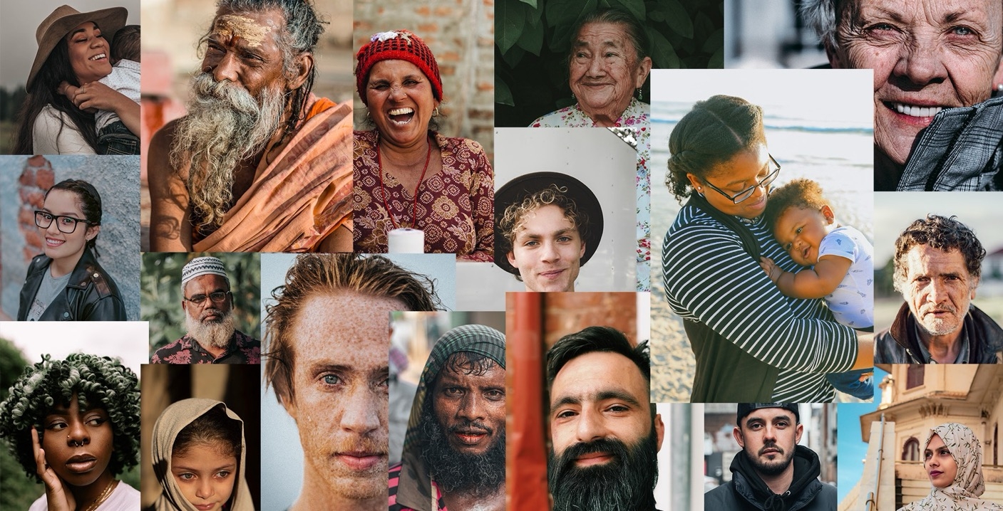
Image of lots of different faces
The mystery of being human.

Slide 58
Taste & See
Week 1
Made of ‘dust’
Then the Lord God formed a man from the dust of the ground and breathed into his nostrils the breath of life, and the man became a living being.
Genesis 2:5-7
Image of lots of different faces
The mystery of being human.

Slide 59
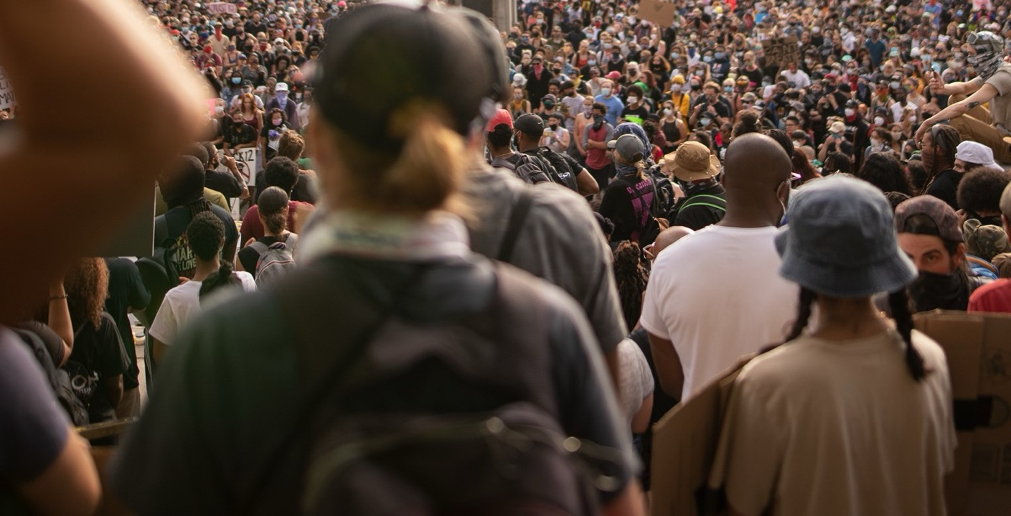
Made of ‘dust’
For God knows how we were formed; He remembers that we are but dust.
Psalm 103:14
Image of lots of different faces
The mystery of being human.

Slide 60
Taste & See
Week 1
Made in God’s Image
Then God said, “Let us make mankind in our image, in our likeness, so that they may rule over the fish in the sea and the birds in the sky, over the livestock and all the wild animals, and over all the creatures that move along the ground.”
So God created mankind in his own image. In the image of God he created them; male and female he created them.
Genesis 1:26-27
It Was Good

Slide 61
Taste & See
Week 1
Q.
If bearing the image of God to the creation and to each other is our role, how do you think we’re doing?

Slide 62
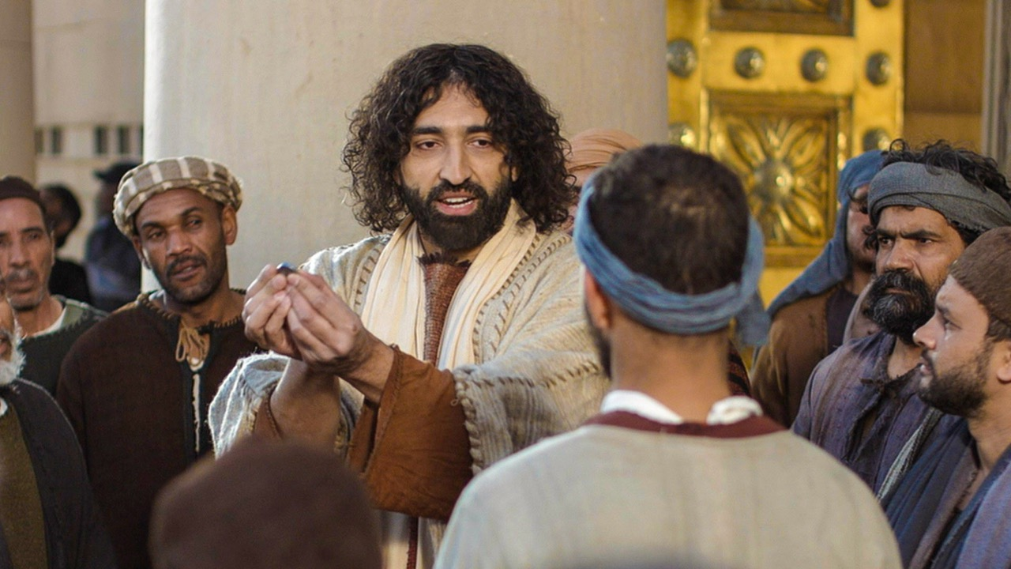
Taste & See
Week 1
www.LumoProject.com
Notes:
‘Give to Caesar the things that are Caesar’s,’ Jesus replied, ‘and give to God the things that are God’s.’

Slide 63
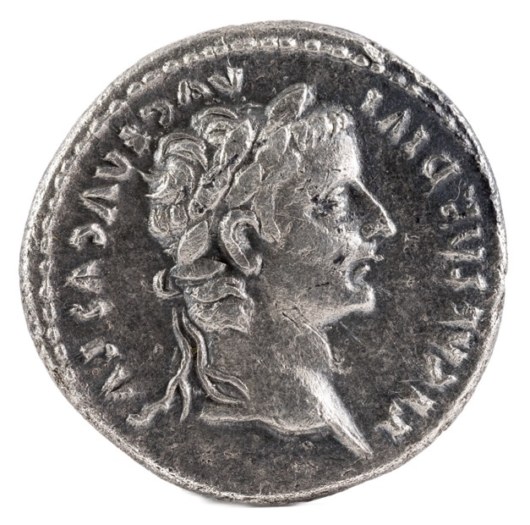
Taste & See
Week 1
The Challenge of the Christian Faith
Give to Caesar what is Caesars’ and to God what is God’s’.
Jesus

Slide 64
Week Two
What’s Gone Wrong?

Slide 65
Taste & See
Week 1
Here dies another day
During which I have had eyes, ears, hands
And the great world round me;
And with tomorrow begins another.
Why am I allowed two?
G.K. Chesterton

Slide 66
Taste & See
Week 1
This week take some time to consider…
The wonder and beauty of Creation all around us.
What does it mean to be made in the image of God?
It Was Good

Slide 67
“Taste and see that the Lord is good; blessed is the one who takes refuge in him.”
Psalm 34:8

Slide 68
EXTRAS

Slide 69
Exploring the heart of the Christian message of hope over four meals.

Slide 70
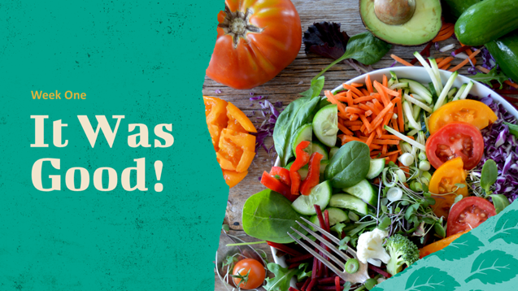
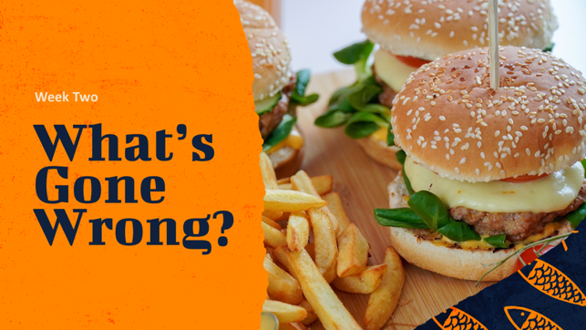

Slide 71
Taste & See
Week 1
This week take some time to consider…
The wonder and beauty of Creation all around us.
What does it mean to be made in the image of God?

Slide 72
Taste & See
Week 1
This week take some time to consider…
The wonder and beauty of Creation all around us.
What does it mean to be made in the image of God?

